Slide 1
Regression and Correlation
Jake Blanchard
Fall 2010

Slide 2
Introduction
We can use regression to find relationships between random variables
This does not necessarily imply causation
Correlation can be used to measure predictability

Slide 3
Regression with Constant Variance
Linear Regression: E(Y|X=x)=α+βx
In general, variance is function of x
If we assume the variance is a constant, then the analysis is simplified
Define total absolute error as the sum of the squares of the errors

Slide 4
Linear Regression

Slide 5
Variance in Regression Analysis
Relevant variance is conditional: Var(Y|X=x)

Slide 6
Confidence Intervals
Regression coefficients are t-distributed with n-2 dof
Statistic below is thus t-distributed with n-2 dof
And the confidence interval is

Slide 7
Example
Example 8.1
Data for compressive strength (q) of stiff clay as a function of “blow counts” (N)

Slide 8
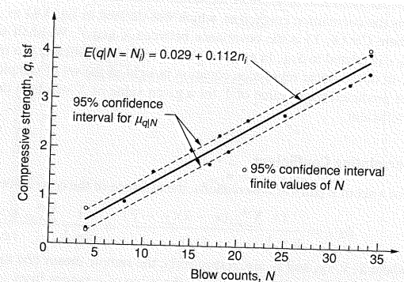
Plot

Slide 9
Correlation Estimate

Slide 10
Regression with Non-Constant Variance
Now relax assumption of constant variance
Assume regions with large conditional variance weighted less

Slide 11
Example (8.2)
Data for maximum settlement (x) of storage tanks and maximum differential settlement (y)
From looking at data, assume g(x)=x (that is, standard deviation of y increases linearly with x

Slide 12
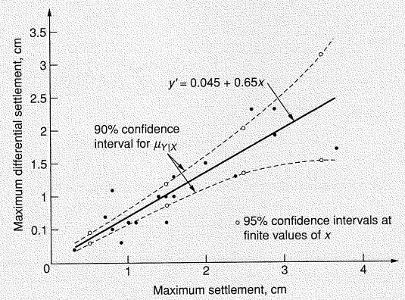
Example (8.2) continued

Slide 13
Multiple Regression
“Nonlinear” Regression
Use LINEST in Excel

