Slide 1
Fitting Input Distributions
Jake Blanchard
University of Wisconsin - Madison
Spring 2008

Slide 2
Introduction
If we have some data for an uncertain input parameter, we need to decide what form of distribution to use as a model and then find a way to fit the model to the data.
Matlab has some tools (in the statistics toolbox) for this purpose
Other tools are BestFit (standalone or in @Risk) and Stat::Fit (standalone – free student version available)

Slide 3
Matlab Fitting Tool
Create data vector
Then open GUI fitting tool
dfittool

Slide 4
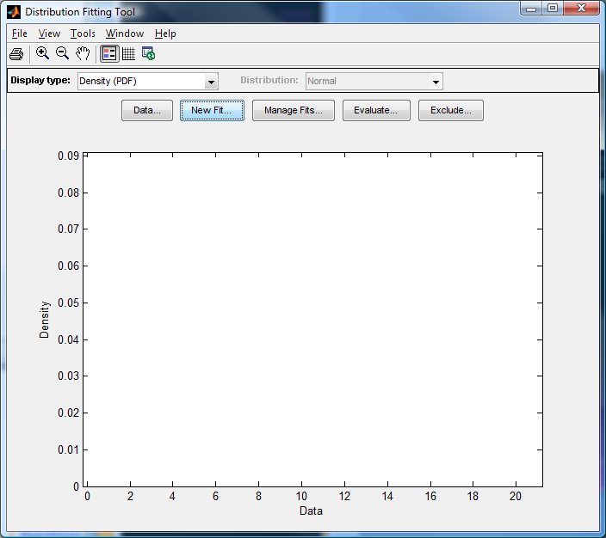

Slide 5
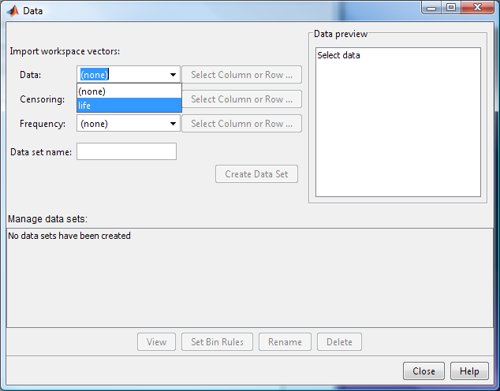

Slide 6
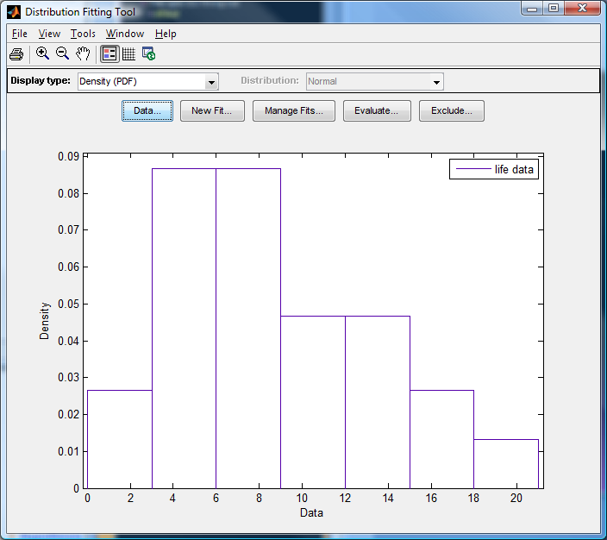

Slide 7
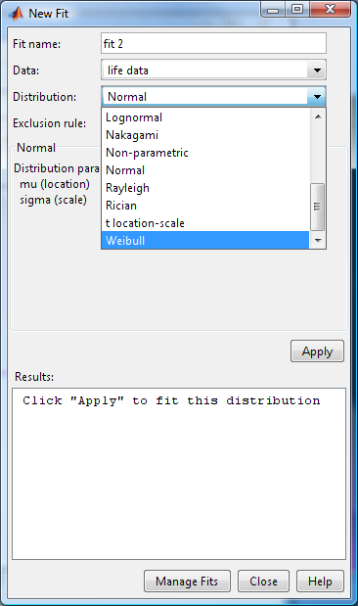

Slide 8
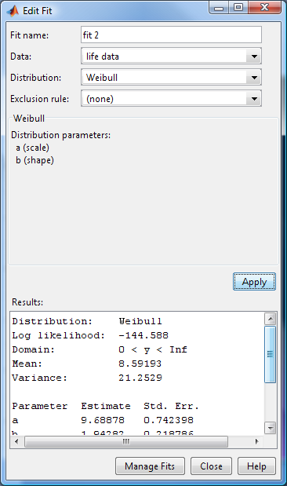

Slide 9
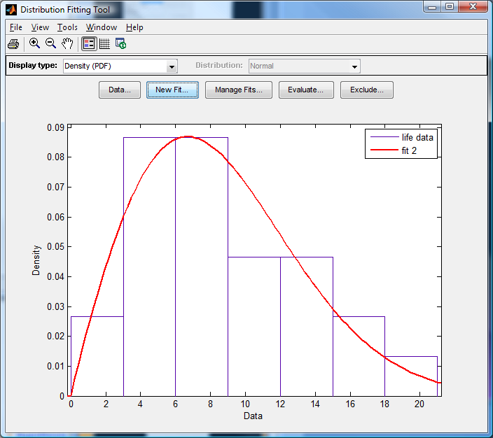

Slide 10
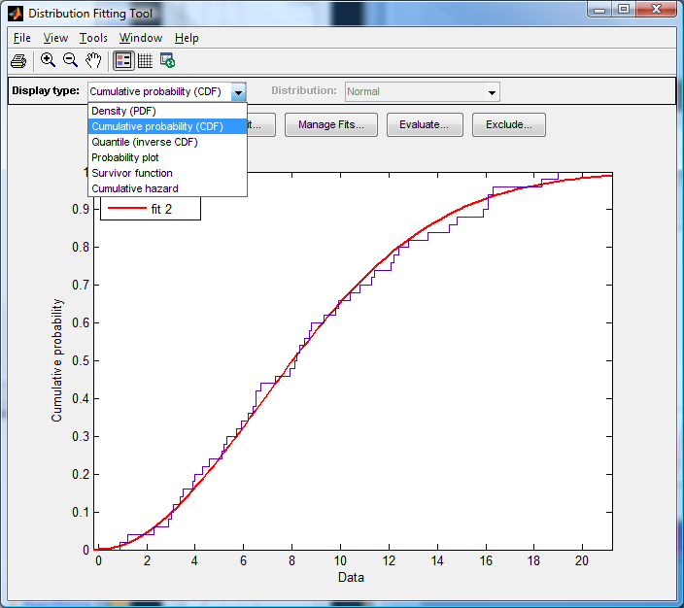

Slide 11
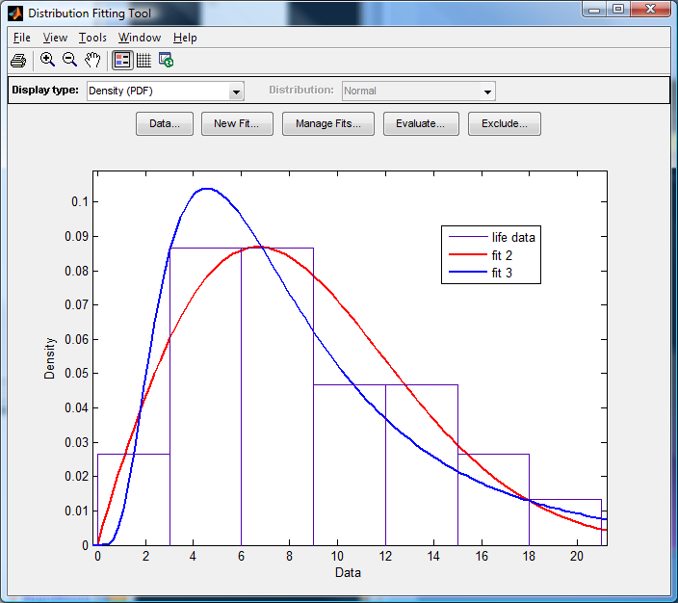
Compare Weibull and Log-Norm

