Slide 1
Statistical Inferences
Jake Blanchard
Spring 2010

Slide 2
Introduction
Statistical inference=process of drawing conclusions from random data
Conclusions of this process are “propositions,” for example
Estimates
Confidence intervals
Credible intervals
Rejecting a hypothesis
Clustering data points
Part of this is the estimation of model parameters

Slide 3
Parameter Estimation
Point Estimation
Calculate single number from a set of observational data
Interval Estimation
Determine interval within which true parameter lies (along with confidence level)

Slide 4
Properties
Bias=expected value of estimator does not necessarily equal parameter
Consistency=estimator approaches parameter as n approaches infinity
Efficiency=smaller variance of parameter implies higher efficiency
Sufficient=utilizes all pertinent information in a sample

Slide 5
Point Estimation
Start with data sample of size N
Example: estimate fraction of voters who will vote for particular candidate (estimate is based on random sample of voters)
Other examples: quality control, clinical trials, software engineering, orbit prediction
Assume successive samples are statistically independent

Slide 6
Estimators
Maximum likelihood
Method of moments
Minimum mean squared error
Bayes estimators
Cramer-Rao bound
Maximum a posteriori
Minimum variance unbiased estimator
Best linear unbiased estimator
etc

Slide 7
Maximum Likelihood
Suppose we have a random variable x with pdf f(x;θ)
Take n samples of x
What is value of θ that will maximize the likelihood of obtaining these n observations?
Let L=likelihood of observing this set of values for x
Then maximize L with respect to θ

Slide 8
Maximum Likelihood

Slide 9
Example
Time between successive arrivals of vehicles at an intersection are 1.2, 3, 6.3, 10.1, 5.2, 2.4, and 7.2 seconds
Assume exponential distribution
Find MLE for λ

Slide 10
Solution

Slide 11
2-Parameter Example
Measure cycles to failure of saturated sand (25, 20, 28, 33, 26 cycles)
Assume lognormal distribution

Slide 12
Solution

Slide 13
Method of Moments
Use sample moments (mean, variance, etc.) to set distribution parameters

Slide 14
Example
Time between successive arrivals of vehicles at an intersection are 1.2, 3, 6.3, 10.1, 5.2, 2.4, and 7.2 seconds
Assume exponential distribution
Mean=5.05

Slide 15
2-Parameter Example
Measure cycles to failure of saturated sand (25, 20, 28, 33, 26 cycles)
Assume lognormal distribution
Mean=26.4
Standard Deviation=4.72
Solve for λ and ζ
λ=3.26
ζ=0.177

Slide 16
Solution

Slide 17
Minimum Mean Square Error
Choose parameters to minimize mean squared error between measured data and continuous distribution
Essentially a curve fit

Slide 18
Approach
Excel
Guess parameters
Calculate sum of squares of errors
Vary guessed parameters to minimize error (use the Solver)
Matlab
Use fminsearch function

Slide 19
Example
Solar insolation data
Gather data
Form histogram
Normalize histogram by number of samples and width of bins

Slide 20
Scatter Plot and Histogram

Slide 21
Normal and Weibull Fits
Mean=3980 (fit)
Mean=3915 (data)

Slide 22
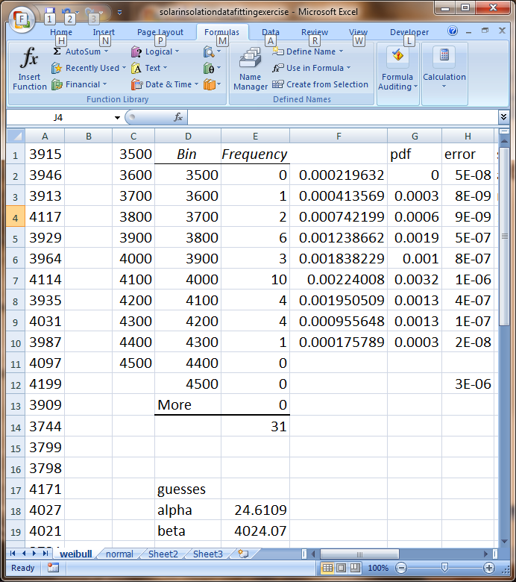
Excel Screen Shot

Slide 23
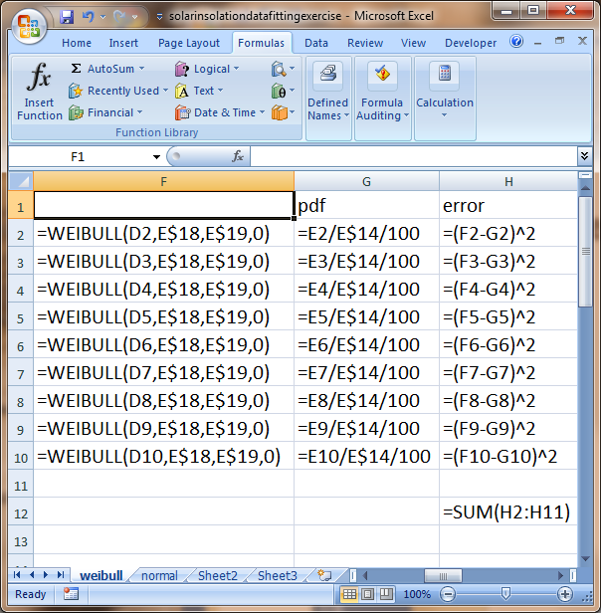
Excel Screen Shot

Slide 24
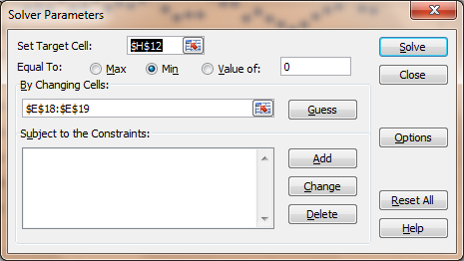
Solver Set Up

Slide 25
Matlab Script
y=xlsread('matlabfit.xlsx','normal')
[s,t]=hist(y,8);
s=s/((max(t)-min(t))/8)/numel(y);
numpts=numel(t);
zin(1)=mean(t);
zin(2)=std(t);
sumoferrs(zin,t,s)
zout=fminsearch(@(z) sumoferrs(z,t,s), zin)
sumoferrs(zout,t,s)
xplot=t(1):(t(end)-t(1))/(10*numel(t)):t(end);
yplot=curve(xplot,zout);
plot(t,s,'+',xplot,yplot)

Slide 26
Matlab Script
function f=curve(x,z)
mu=z(1);
sig=z(2);
f=normpdf(x,mu,sig);
function f=sumoferrs(z, x, y)
f=sum((curve(x,z)-y).^2);

Slide 27
Sampling Distributions
How do we assess inaccuracy in using sample mean to estimate population mean?

Slide 28
Conclusions
Expected value of mean is equal to population mean
Mean of sample is unbiased estimator of mean of population
Variance of sample mean is sampling error
By CLT, sample mean is Gaussian for large n
Mean of x is N(μ,σ/√n)
Estimator for μ improves as n increases

Slide 29
Sample Mean with Unknown σ
In previous derivation, σ is the population mean
This is generally not known
All we have is the sample variance (s²)
If sample size is small, distribution will not be Gaussian
We can use a “student’s t-distribution”
f=number of degrees of freedom

Slide 30
Distribution of Sample Variance

Slide 31
Conclusions
Sample variance is unbiased estimator of population variance
For normal variates
This approaches normal distribution for large n
Chi-Square Distribution with n-1 dof

Slide 32
Testing Hypotheses
Used to make decisions about population based on sample
Steps
Define null and alternative hypotheses
Identify test statistic
Estimate test statistic, based on sample
Specify level of significance
Type I error: rejecting null hypothesis when it is true
Type II error: accepting null hypothesis when it is false
Define region of rejection (one tail or two?)

Slide 33
Level of Significance
Type I error
Level of significance (α)
Typically 1-5%
Type II error (β) is seldom used

Slide 34
Example
We need yield strength of rebar to be at least 38 psi
We order sample of 25 rebars
Sample mean from 25 tests is 37.5 psi
Standard deviation of rebar strength =3 psi
Use one-sided test
Hypotheses: null-μ=38; alt.- μ<38

Slide 35
Solution
So we cannot reject the null hypothesis and the supplier is considered acceptable

Slide 36
Variation of This Example
Suppose standard deviation is not known
Use student’s t-distribution
Sample stand. dev. = 3.5 psi
So we cannot reject the null hypothesis and the supplier is considered acceptable

Slide 37
Third Variation
Sample size increased to 41
Sample mean=37.6 psi
Sample standard deviation = 3.75 psi
Null-variance=9
Alternative-variance>9
Use Chi-Square distribution

Slide 38
Solution
So we reject the null hypothesis and the supplier is not acceptable

Slide 39
Confidence Intervals
In addition to mean, standard deviation, etc., confidence intervals can help us characterize populations
For example, the mean gives us a best estimate of the expected value of the population, but confidence intervals can help indicate the accuracy of the mean
Confidence interval is defined as the range within which a parameter will lie – within a prescribed probability

Slide 40
CI of the Mean
First, we’ll assume the variance is known
The central limit theorem states that the pdf of the mean of n individual observations from any distribution with finite mean and variance approaches a normal distribution as n approaches infinity

Slide 41
CI of the Mean
Φ Is CDF of standard normal variate

Slide 42
Example
Measure strength of rebar
25 samples
Mean=37.5 psi
Standard deviation=3 psi
Find 95% confidence interval for mean

Slide 43
Solution
So the mean of the strength falls between 36.3 and 38.7 with a 95% confidence level

Slide 44
The Script
mu=37.5
sig=3
n=25
alpha=0.05
ka=-norminv(1-alpha/2)
k1ma=-ka
cil=mu+ka*sig/sqrt(n)
ciu=mu-ka*sig/sqrt(n)

Slide 45
Variance Not Known
What if the variance of the population (σ) is not known?
That is, we only know variance of sample.
Let s=standard deviation of sample
We can show that
does not conform to a normal distribution, especially for small n

Slide 46
Variance Not Known
We can show that this quantity follows a Student’s t-distribution with n-1 degrees of freedom (f)

Slide 47
Example
Measure strength of rebar
25 samples
Mean=37.5 psi
s=3.5 psi
Find 95% confidence interval for mean

Slide 48
Script
Result is 36.06, 38.94
xbar=37.5;
s=3.5;
n=25;
alpha=0.05;
ka=-tinv(1-alpha/2,n-1);
kb=-tinv(alpha/2,n-1);
cil=xbar+ka*s/sqrt(n)
ciu=xbar+kb*s/sqrt(n)

Slide 49
One-Sided Confidence Limit
Sometimes we only care about the upper or lower bounds
Lower
Upper

Slide 50
Example
100 steel specimens – measure strength
Mean=2200 kgf; s=220 kgf
Specify 95% confidence limit of mean
Assume σ=s=220 kgf
1-α=0.95; α=0.05
Manufacturer has 95% confidence that yield strength is at least 2164 kgf

Slide 51
Example
Now only 15 steel specimen
Mean=2200 kgf; s=220 kgf
Specify 95% confidence limit of mean
Manufacturer has 95% confidence that yield strength is at least 2100 kgf

Slide 52
Confidence Interval of Variance

Slide 53
Example
25 storms, sample variance for measured runoff is 0.36 in²
Find upper 95% confidence limit for variance
So, we can say, with 95% confidence, that the upper bound of the variance of the runoff is 0.624 in² and the upper bound of the standard deviation is 0.79 in

Slide 54
Script
var=0.36
n=25
alpha=0.05
c=chi2inv(alpha,n-1)
ci=1/c*var*(n-1)
si=sqrt(ci)

Slide 55
Measurement Theory
Suppose we are measuring distances
d₁, d₂, …, d_{n} are measured distances
Distance estimate is
Standard error is
s=standard deviation of sample
d is the expected value of the mean

