Slide 1
Monte Carlo Simulation in Excel
Jake Blanchard
Spring 2010

Slide 2
Monte Carlo Simulation in Excel
There are at least three ways to do MCS in Excel
Fill a bunch of cells with appropriate random numbers
Write a macro in VBA
Use an add-in (Crystal Ball, @Risk, etc.)

Slide 3
Filling Cells
Advantages
Everyone has Excel
Everyone is familiar with formulas in cells
Disadvantages
Slow
Cumbersome if you need many samples
Not many built-in distributions

Slide 4
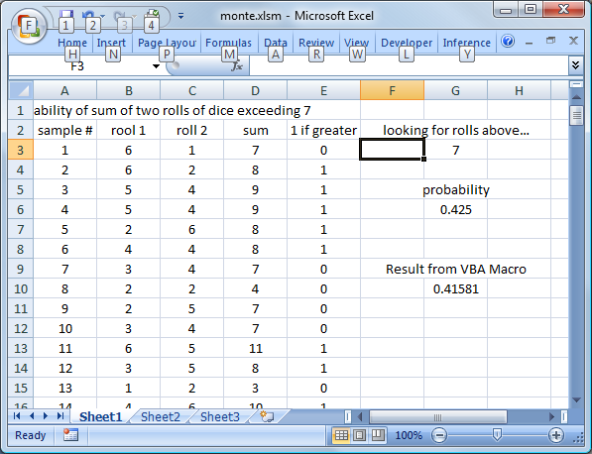
Typical Sheet

Slide 5
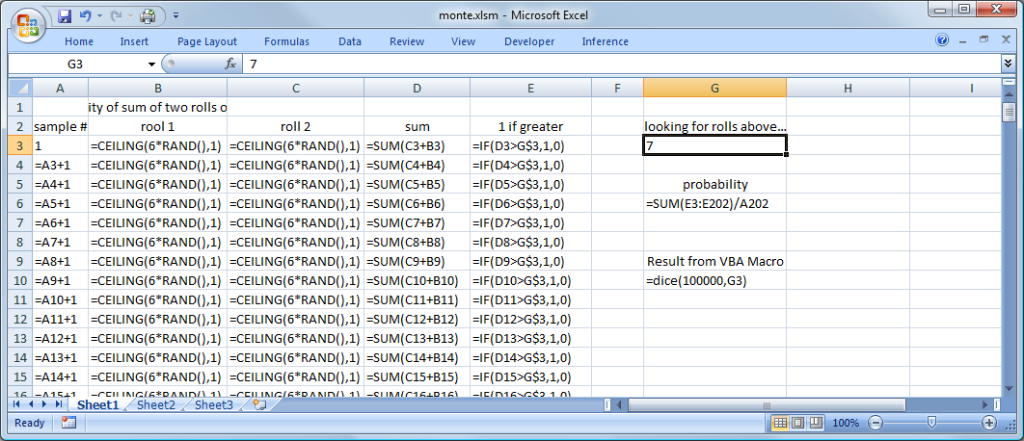
Formulas

Slide 6
Scripting in VBA
Start editor from Developer Tab in Excel 2007
If you don’t see Developer Tab, Go to Office Button in upper left and then to Excel Options (at bottom of window)
Once editor opens, go to Insert/Module in VBA editor
Then paste in script on next page

Slide 7
The Script
Function dice(N, above)
Count = 0
For i = 1 To N
roll1 = Ceil(6 * Rnd)
roll2 = Ceil(6 * Rnd)
tot = roll1 + roll2
If tot > above Then
Count = Count + 1
End If
Next
dice = Count / N
End Function
Public Function Ceil(ByVal X As Double) As Double
Ceil = (Int(X) - (X - Int(X) > 0))
End Function

Slide 8
Built-In Tools
Crystal Ball and @Risk both add Monte Carlo Simulation capability into Excel
In @Risk
Build a model, assuming all parameters are deterministic
Replace random variables with appropriate pdf’s
Identify output variables
Run simulation
Look at output

