Slide 1
Random Number Generators
Jake Blanchard
Spring 2010

Slide 2
A Little History
Initial random number generators were congruential
For example, a=13, c=0, m=31, x₀=1

Slide 3
Congruential Operators
Result is integers between 1 and 30
To get U(0,1), divide by m (31)
This gives .0323, .4194, .4516, etc.
This gives just 30 possible floating point numbers

Slide 4
Congruential Algorithms
Years ago, IBM mainframes use a=65539, c=0, m=2³¹ because it was very fast
But it has issues – consecutive numbers are correlated
For example, suppose we want to generate random points in a cube.
We would use 3 consecutive values for the x, y, z coordinates of a random point
(See ssp script)

Slide 5
Matlab
Matlab has 3 prominent functions: rand, randn, and randi
Until 1995, rand was congruential (a=7⁵=16807, c=0, m=2³¹-1)
This repeats every 2 billion numbers (roughly)
(see mcg script)

Slide 6
Shuffling
This Matlab routine still has correlation among consecutive numbers
For example, if x<10⁻⁶, next number will be less than 0.0168
To avoid this, shuffle numbers (Matlab didn’t do this)
Start by storing 32 random numbers
When routine is called, randomly select which of the 32 to use and replace with next number in sequence

Slide 7
New Matlab Algorithm
Matlab now uses a look up algorithm
Not congruential, no multiplication or division, produces floating point directly
Uses 35 words of memory
32 represent cached floating point numbers – 0<z<1
Last three contain index i – 0<i<31, integer j, and borrowflag b
Subscripts are modulo 32

Slide 8
New Matlab Algorithm
b is used to make sure z is positive
Period is 2¹⁴³⁰
Small modifications make period 2¹⁴⁹²

Slide 9
Repeatability
In new Matlab session, the first output from rand is always 0. 814723686393179
Matlab will let you repeat a sequence at any time
defaultStream=RandStream.getDefaultStream;
savedState = defaultStream.State;
u1 = rand(1,5)
defaultStream.State = savedState;
u2 = rand(1,5)

Slide 10
Normal Deviates
One approach is to use
sum(rand(m,n,12),3)-6
This adds the 12 uniform deviates for each number, yielding something approximating a normal deviate with mean of 0 and variance of 1

Slide 11
Normal Deviates
Alternative is rejection method
Generate uniform random numbers in 2 by 2 square and reject points outside unit circle
For accepted points,
Result is 2 normally distributed random numbers

Slide 12
Newer Matlab Algorithm
Divide pdf into rectangles of equal area
Randomly sample integer to pick rectangle and then see if u(-1,1) falls within rectangle
If u is in jth section, then u*z is a normal deviate
Otherwise, reject

Slide 13
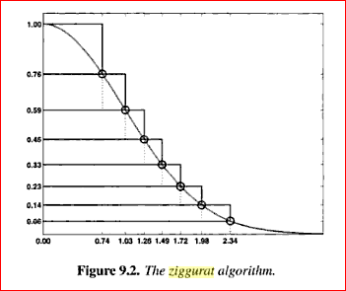
Matlab Algorithm

Slide 14
Other Distributions
If cdf can be inverted, you can sample them directly
See later slides

