Slide 1
Monte Carlo Analysis
Jake Blanchard
University of Wisconsin - Madison
Spring 2010

Slide 2
Introduction
Monte Carlo analysis is a common way to carry out uncertainty analysis
There are tools you can add in to Excel, but we will start by doing some of this on our own.
I will use Matlab, but other tools work as well.

Slide 3
Monte Carlo Analysis
The general idea is to sample the inputs, run a model, and thus get sampled output
We can then look at averages, variances, probability distributions, etc., for the output
Decisions can then be made from these results

Slide 4
An example: dice
How can we simulate the rolling of a dice?
If we could simulate such a thing, what questions could we answer?
What is probability of rolling a 6?
What is the probability of rolling snake eyes?
What is the probability of two dice summing to 7?

Slide 5
Simple Code for Dice
d=randperm(6)
or
n=1000000;
roll1=ceil(6*rand(n,1));
roll2=ceil(6*rand(n,1));
tot=roll1+roll2;
six=numel(find(roll1==6));
prob=six/n
snakeeyes=numel(find(tot==2));
prob=snakeeyes/n
sevens=numel(find(tot==7));
prob=sevens/n

Slide 6
Other questions
What is accuracy as function of number of samples?

Slide 7
Plot

Slide 8
Code for Error Plot
clear all
n=1000;
ntries=100;
roll1=ceil(6*rand(n,ntries));
roll2=ceil(6*rand(n,ntries));
tot=roll1+roll2;
for i=1:ntries
sevens=numel(find(tot(:,i)==7));
prob(i)=sevens/n;
end
mean(prob)
std(prob)

Slide 9
More Monte Carlo
Monte Carlo approaches are also applicable to other types of problems:
Particle transport
Random walk
Numerical integration (especially many-dimensional)

Slide 10
An Example
Random walk
Assume path length per step is fixed
Randomly sample angle at which step is taken
Repeat many times and study resulting path
This is not the only algorithm for random walk. Many limit to finite number of directions and vary length from jump to jump

Slide 11
Sample
clear all
steplen=1;
startx=0;
starty=0;
nsteps=100;
angle=2*pi*rand(nsteps,1);
dx=steplen*cos(angle);
dy=steplen*sin(angle);
x(1)=startx;
y(1)=starty;
for i=2:nsteps
x(i)=x(i-1)+dx(i-1);
y(i)=y(i-1)+dy(i-1);
end
plot(x,y,0,0,'ro','LineWidth',2)

Slide 12
4 Runs for 5 Steps Each

Slide 13
4 Runs for 50 Steps Each

Slide 14
Another Example
Numerical integration (2-D, in this case)
Draw area within a square
Randomly locate points within the square
Count up the number of points (N) within the area
Area=area of square*number points inside area/N

Slide 15
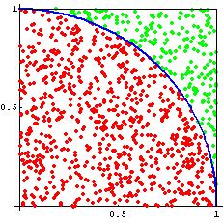
Finding the Area of a Circle

Slide 16
Example
clear all
squaresidelength=2;
area=squaresidelength.^2;
samples=100000;
x=squaresidelength*(-0.5+rand(samples,1));
y=squaresidelength*(-0.5+rand(samples,1));
outside=floor(2*sqrt(x.^2+y.^2)/squaresidelength);
circarea=(1-sum(outside)/samples)*area

Slide 17
Another Example
If we have 20 people in a room, what is the probability that at least two will have birthdays on the same day

Slide 18
Source
nump=23;
samples=10000;
birthd=ceil(365*rand(nump,samples));
count=0;
for j=1:samples
if numel(birthd(:,j))-numel(unique(birthd(:,j))) >0
count=count+1;
end
end
probab=count/samples;

Slide 19
Characteristics of Monte Carlo Approaches
We have to sample enough times to get reasonable results
Accuracy only increases like sqrt(N)
Computation times are typically long
Development time is typically relatively short
These are a trade-off

Slide 20
Our Case Study
Consider a cantilever beam of length L with a circular cross section of radius R
The deflection of such a beam, loaded at the end, is given by
F
L

Slide 21
Parameters
F varies from 600 N to 800 N (uniformly)
R varies from 2 cm to 2.4 cm (uniformly)
E varies from 185 to 200 GPa (uniformly)
L varies from 1 m to 1.05 m (uniformly)
What is average displacement?
What does probability distribution look like?

Slide 22
Uniform Distributions
Most codes produce random numbers (R_{n}) between 0 and 1 with uniform distributions
To get a uniform distribution from a to b, you can use

Slide 23
Normal Distributions
These are like the well-known bell curve
Codes often give normal distribution with mean of 0 and standard dev. of 1
We can use the following formula to generate a normal distribution with mean of M and standard dev. of σ

Slide 24
Matlab
Matlab has several tools for random number generation
RAND() produces matrices of uniform numbers
RANDN() produces matrices of random numbers with normal distributions

Slide 25
Using Matlab
Put random numbers in a vector
Use mean function
a=2
b=7
randnumbers=a+(b-a)*rand(5,1)
mean(randnumbers)

Slide 26
Basic Analytical Functions
mean
std – standard deviation
hist(v,n) – gives histogram of set of numbers in vector v, using n bins

Slide 27
Example
Generate 1,000 random numbers uniformly distributed between 10 and 12 and calculate mean
Repeat for 10⁴, 10⁵, and 10⁶ samples
Plot histogram for last case
Note: previous code was
a=2
b=7
randnumbers=a+(b-a)*rand(5,1)
mean(randnumbers)

Slide 28
Case Study
Complete case study for beam deflections
Download the file beam.m and adapt to find mean deflection and histogram of deflections
n=100;
f=600+200*rand(n,1);
r=0.02+0.004*rand(n,1);
emod=(185+15*rand(n,1))*1e9;
l=1+0.05*rand(n,1);
inert=pi*r.^4/4;
delta=f.*l.^3/3./emod./inert;
mm=mean(delta);
hist(delta,60)

Slide 29
Result

Slide 30
Other Sampling Approaches
Distribution | Equation | Limits | Sampling
Uniform |  | a<x<b | y’=a+(b-a)R_{u}
Exponential |  | μ<y<∞
Lognormal | Lognormal(λ,ζ) | 0<y<∞ | y’=exp(ζR_{N}+λ)
Weibull |  | 0<y<∞
Normal | F=N(μ, σ) | 0<y<∞ | y’=σR_{N}+μ

Slide 31
Built-In Matlab Commands
Y = random(name,A,B,C,…,m,n) returns an mxn array of random values fitting a distribution of type “name” with necessary parameters A, B, C, etc
Names:
beta, bino, chi2, exp, ev, f, gam, gev, gp, geo, hyge, logn, nbin, ncf, nct, ncx2, norm, poiss, rayl, t, unif, unid, wbl

Slide 32
Other Built-In Commands
Matlab also has commands like:
R = normrnd(mu,sigma,m,n)
Others include
wblrnd
binornd
gamrnd
lognrnd
betarnd
etc

Slide 33
Example
Consider three random variables: X, Y, and Z
All are lognormal
If W=X+Y,+Z what are mean and std of W?

Slide 34
First solution
n=1000000
x=lognrnd(6.1,0.47,n,1);
y=lognrnd(6.25,0.55,n,1);
z=lognrnd(6.35,0.63,n,1);
w=x+y+z;
hist(w,120);
m=mean(w)
s=std(w)
sk=skewness(w)
p50=prctile(w,50)
p95=prctile(w,95)

Slide 35
Alternate Solution
n=1000000
x=random('logn',6.1,0.47,n,1);
y=random('logn',6.25,0.55,n,1);
z=random('logn',6.35,0.63,n,1);
w=x+y+z;
hist(w,120);
m=mean(w)
s=std(w)
sk=skewness(w)
p50=prctile(w,50)
p95=prctile(w,95)

Slide 36
Third Solution
n=10000000
x=exp(0.47*randn(n,1)+6.1);
y=exp(0.55*randn(n,1)+6.25);
z=exp(0.63*randn(n,1)+6.35);
w=x+y+z;
hist(w,120);
m=mean(w)
s=std(w)
sk=skewness(w)

Slide 37
Example
W=X*Z/Y
X=N(500,75)
Y=N(600,120)
Z=N(700,210)

Slide 38
Solution
n=1000000
x=random('norm',500,75,n,1);
y=random('norm',600,120,n,1);
z=random('norm',700,210,n,1);
w=x.*z./y;
hist(w,120);
m=mean(w)
s=std(w)
sk=skewness(w)

Slide 39
Example
The allowable wind pressures on a building, based on the strength of the superstructure and foundation are S and F, respectively
The actual wind pressure on the building is W
Find failure probability of entire system

Slide 40
Continued
S=N(70, 15) pounds per square foot
F=N(60, 20) psf
W=0.001165 CV²
C=N(1.8, 0.5)
V=100-ln(ln(1/u))/0.037
u=U(0,1)

Slide 41
PDF for V

Slide 42
PDF for W

Slide 43
Solution
n=1000000
S=normrnd(70,15,n,1);
F=normrnd(60,20,n,1);
C=normrnd(1.8,0.5,n,1);
V=100-log(log(1./rand(n,1)))/0.037;
hist(V,120)
W=0.001165.*C.*V.^2;
figure, hist(W,120)
pff=sum(W>F)/n
pfs=sum(W>S)/n
total=sum(W>F|W>S)/n

Slide 44
Latin Hypercube Sampling
As we said, Monte Carlo analysis can be slow
We can speed it up by sampling more carefully
A common approach is LHS

Slide 45
LHS Approach
For each random variable, divide range into n non-overlapping intervals
Select a random value in each interval for each variable
Randomly select one value from each list and use in MC calculation

Slide 46
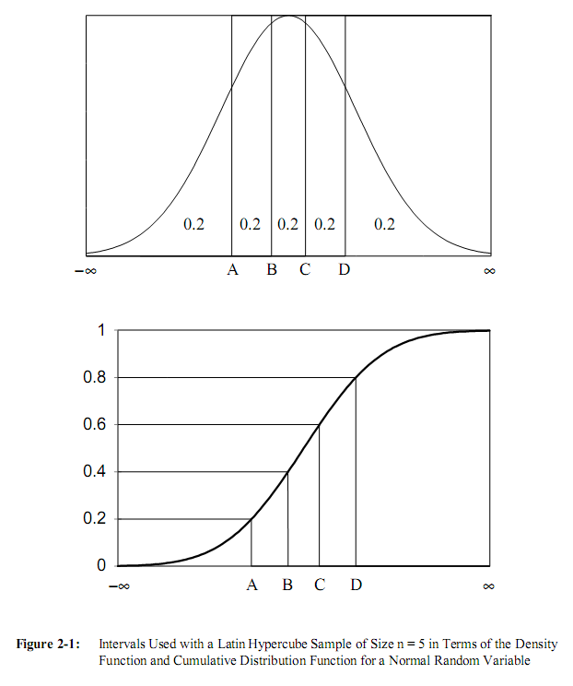

Slide 47
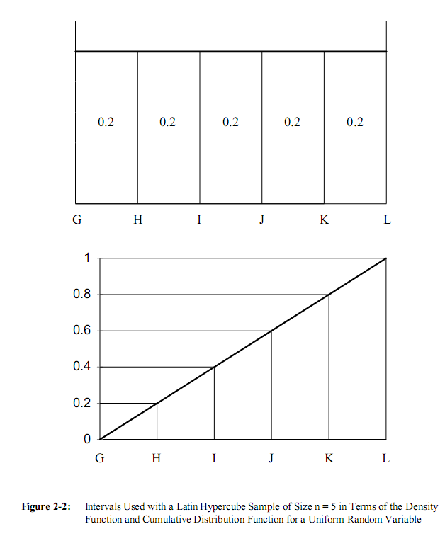

Slide 48
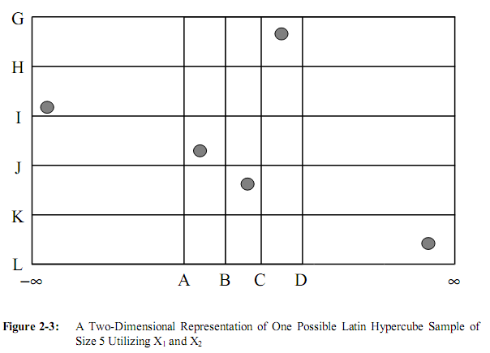

Slide 49
Matlab Example
clear all
n=100;
mu=0;
st=1;
a=lhsnorm([mu mu],[st 0;0 st],n);
subplot(1,2,1), plot(a(:,1),a(:,2),'o')
axis([-4 4 -4 4])
x=randn(n,1);
y=randn(n,1);
subplot(1,2,2), plot(x,y,'o')
axis([-4 4 -4 4])

Slide 51
A Test
Compare sampling with and without LHS
Use mean if sample as measure
Run simulation of 10,000 points 100 times and find mean and std

Slide 52
Code
n=10000; mu=0; st=1;
for ii=1:100
a=lhsnorm([mu mu],[st 0;0 st],n);
x=randn(n,1);
y=randn(n,1);
ma(ii)=mean(a(:,1));
mb(ii)=mean(a(:,2));
mx(ii)=mean(x); my(ii)=mean(y);
t(ii)=ii;
end
mean(ma); mean(mb); mean(mx); mean(my)

Slide 53
Results
 | Mean | STD
LHS X | 4.1e-7 | 3.3e-5
LHS Y | 3.6e-6 | 3.4e-5
X | 0.0017 | .010
Y | 9.8e-5 | .011

Slide 54
Monte Carlo with Correlated Variables
Suppose we need to model two random variables which are correlated?
We have pdfs like f_{x,y}(x,y) or cdfs like F_{x,y}(x,y)
We need to sample them so that we reproduce these distributions?

Slide 55
Bivariate distributions
These joint distribution functions give probability for all possible values of x and y
Facts:
F_{x,y}(-∞,- ∞)=0
F_{x,y}(-∞,y)=0
F_{x,y}(∞,∞)=1
F_{x,y}(∞,y)=F_{y}(y)
F is non-negative and monotonic

Slide 56
Conditional and Marginal Distributions
The probability of x may depend on the value of y (or vice versa)
Conditional pdf is defined as f_{x|y}(x|y)
Marginal pdfs are f_{x}(x) and f_{y}(y)

Slide 57
Derivation

Slide 58
How do we sample these

Slide 59
Approach
Sample x using U(0,1) and marginal distribution for x
Then y is sampled using the conditional distribution

Slide 60
Note: For Bivariate Normal Distributions

Slide 61
How can we use these?
Sample x as a normal variable
For each x, calculate the mean and standard deviation for the conditional distribution
Then, for each x, sample y assuming it is a normal variate using the mean and standard deviation for the conditional distribution

Slide 62
Example
Consider a case where x and y are both normal
µ_{x}=150 and µ_{y}=120
std_{x}=20 and std_{y}=25
correlation coefficient=0.75
Now generate vectors of values for x and y that capture these values

Slide 63
The Script
n=100000
x=normrnd(150,20,n,1);
%now get cond mean of y for each x
uy=120+0.75*(25/20)*(x-150);
sy=25*sqrt(1-0.75^2);
y=normrnd(uy,sy);
mean(x)
std(x)
mean(y)
std(y)
cc=corrcoef(x,y)

Slide 64
A Second Example
x is lognormal – mean=150, cov=0.13
y is lognormal – mean=120, cov=0.21
Correlation between ln(x) and ln(y) is 0.75

Slide 65
Script
n=10^7; xmean=150; xcov=0.13;
ymean=120; ycov=0.21; cc=0.75
xxi=sqrt(log(1+xcov^2));
xlam=log(xmean)-xxi^2/2;
x=lognrnd(xlam,xxi,n,1);
A=log(x);
uB=log(ymean)+cc*(ycov/xcov)*(A-log(xmean));
sB=ycov*sqrt(1-cc^2);
B=normrnd(uB,sB);
y=exp(B);
mean(x)
std(x)/mean(x)
mean(y)
std(y)/mean(y)
cc=corrcoef(log(x),log(y))

Slide 66
More General

Slide 67
More General

Slide 68
More General

Slide 69
Some Analytical Results

Slide 70
The Script
n=100000
u1=unifrnd(0,1,n,1);
x=-2+2*sqrt(1+3*u1);
u2=unifrnd(0,1,n,1);
yx=-x/2+1/2*sqrt(x.^2+64*u2+16*u2.*x);
mean(x)
std(x)
mean(yx)
std(yx)
cc=corrcoef(x,yx)

