Slide 1
Summary Statistics
Jake Blanchard
Spring 2008

Slide 2
Summarizing and Interpreting Data
It is useful to have some metrics for summarizing statistical data (both input and output)
3 key characteristics are
central tendency (mean, median, mode)
Dispersion (variance)
Shape (skewness, kurtosis)

Slide 3
Central Tendency
Mean
Median=point such that exactly half of the probability is associated with lower values and half with greater values
Mode=most likely value (maximum of pdf)

Slide 4
For 1 Dice

Slide 5
Radioactive Decay
For our example, the mean, median, and mode are given by
The mode is x=0

Slide 6
Other Characteristics
We can calculate the expected value of any function of our random variable as

Slide 7
Some Results

Slide 8
Moments of Distributions
We can define many of these parameters in terms of moments of the distribution
Mean is first moment.
Variance is second moment
Third and fourth moments are related to skewness and kurtosis

Slide 9
Spread (Variance)
Variance is a measure of spread or dispersion
For discrete data sets, the biased variance is:
and the unbiased variance is
The standard deviation is the square root of the variance

Slide 10
Skewness
skewness is a measure of asymmetry
For discrete data sets, the biased skewness is related to:
The skewness is often defined as

Slide 11
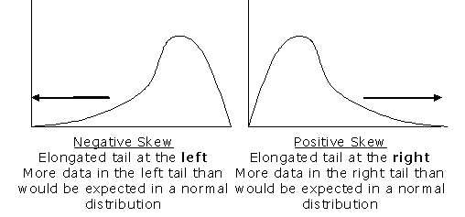
Skewness

Slide 12
Kurtosis
kurtosis is a measure of peakedness
For discrete data sets, the biased kurtosis is related to:
The kurtosis is often defined as

Slide 13
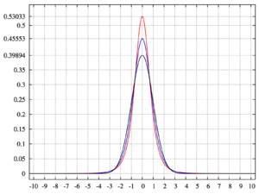
Kurtosis
Pdf of Pearson type VII distribution with kurtosis of infinity (red), 2 (blue), and 0 (black)

Slide 14
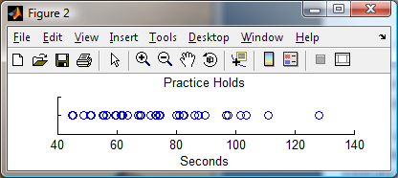
Using Matlab
Sample data is length of time a person was able to hold their breath (40 attempts)
Try a scatter plot
load RobPracticeHolds;
y = ones(size(breathholds));
h1 = figure('Position',[100 100 400 100],'Color','w');
scatter(breathholds,y);

Slide 15
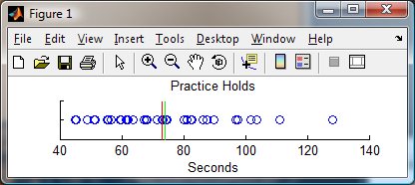
Adding Information
disp(['The mean is ',num2str(mean(breathholds)),' seconds (green line).']);
disp(['The median is ',num2str(median(breathholds)),' seconds (red line).']);
hold all;
line([mean(breathholds) mean(breathholds)],[0.5 1.5],'color','g');
line([median(breathholds) median(breathholds)],[0.5 1.5],'color','r');

Slide 16
Box Plot
title('Scatter with Min, 25%iqr, Median, Mean, 75%iqr, & Max lines');
xlabel('');
h3 = figure('Position',[100 100 400 100],'Color','w'); boxplot(breathholds,'orientation','horizontal','widths',.5);
set(gca,'XLim',[40 140]);
title('A Boxplot of the same data'); xlabel(''); set(gca,'Yticklabel',[]); ylabel('');

Slide 17
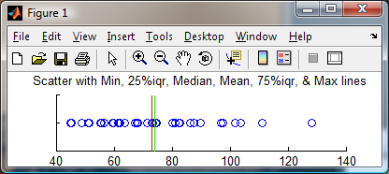
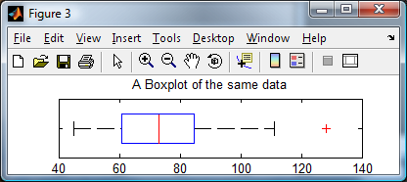
Box Plot
Min
Box represents inter-quartile range (half of data)
Median
Max
Outlier

Slide 18
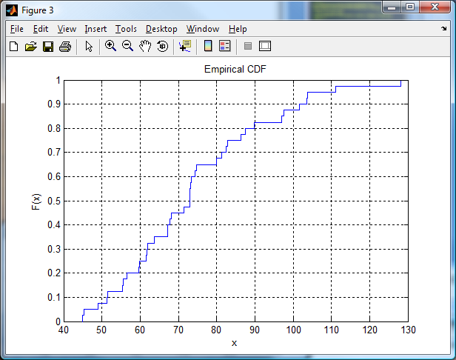
Empirical cdf
h3 = figure('Position',[100 100 600 400],'Color','w');
cdfplot(breathholds);

Slide 19
Multivariate Data Sets
When there are multiple input variables, we need some additional ways to characterize the data
If x and y are independent, then Cov(x,y)=0

Slide 20
Correlation Coefficients
Two random variables may be related
Define correlation coefficient of input (x) and output (y) as
ρ=1 implies linear dependence, positive slope
ρ=0 no dependence
ρ=-1 implies linear dependence, negative slope

Slide 21
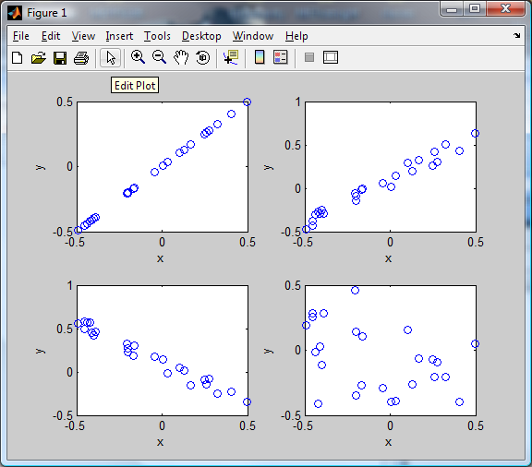
Example
ρ=1
ρ=0.98
ρ=-0.38
ρ=-0.98

Slide 22
Example
x=rand(25,1)-0.5;
y=x;
corrcoef(x,y)
subplot(2,2,1), plot(x,y,'o')
y2=x+0.2*rand(25,1);
corrcoef(x,y2)
subplot(2,2,2), plot(x,y2,'o')
y3=-x+0.2*rand(25,1);
corrcoef(x,y3)
subplot(2,2,3), plot(x,y3,'o')
y4=rand(25,1)-0.5;
corrcoef(x,y4)
subplot(2,2,4), plot(x,y4,'o')

