Slide 1
Discrete Distribution Functions
Jake Blanchard
Spring 2010

Slide 2
Binomial Distributions
Many problems involve repeated, independent trials in which each trial has two possible outcomes and probability of success is a constant
Best example is coin tossing

Slide 3
Other examples
Ten space shots are planned. Probability of success is 0.95. What are chances that at least 9 are successful?
10 numbers are rounded to nearest integer. What is probability that half are rounded up and half down?
20 sales presentations are planned. The probability of receiving orders is 1/3. What is the probability of getting at least 10 orders?

Slide 4
Binomial distribution
The probability of x successes and (n-x) failures in n trials is p^{x}(1-p)^{n-x}, where p is the probability of success on a single trial
The probability of exactly x successes in n independent trials is

Slide 5
Binomial Distribution
The binomial cdf is thus
E(x)=np
Var(x)=np(1-p)

Slide 6
Plots of pdf for n=10

Slide 7
Example
Select 20 units at random from a manufacturing lot. The lot is accepted if there are less than 4 defective units among the 20. If the average defect rate is 10%, what is the probability of acceptance?
binocdf(3,20,0.1)

Slide 8
Hypergeometric Distribution
This is the probability of exactly x successes in n trials when n is not small relative to the population size
Useful when sampling from a small lot
For N=total units, k=defective units in sample, n=sample size, x=successes

Slide 9
Geometric Distribution
The probability that (x-1) failures will be followed by a success is
The probability that the first failure will occur on the x^{th} trial is

Slide 10
The Poisson Distribution
Question: What is the probability that exactly x customers will enter a store during a particular time interval?
Binomial distribution cannot help us, in part because we don’t know what to use for a sample size. Also, some customers might come more than once.
So instead of using a probability per trial, we can use data for the average number of arrivals.

Slide 11
Poisson distribution
Distribution describes number of events occurring within a fixed time interval
For example, number of counts on a radiation detector
If, in a time interval, we expect α events, then P is the probability that there are exactly k occurrences within an interval

Slide 12
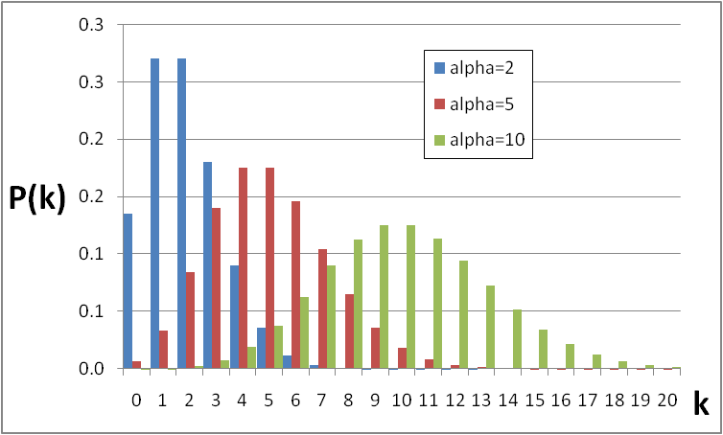
Poisson Distribution

Slide 13
Uses
Number of alpha particles emitted by a source in a specified time interval
Number of incoming calls per minute on a switchboard
Number of insurance claims per year
Number of flaws in similar pieces of material
Number of bacteria on a slide
Number of bombs falling on equal areas of land in London

Slide 14
Example
Flaws in a weld arise independently at a rate of two flaws per weld
What is the probability the weld has 0, 1, 2, or 3 defects?
Solution: α=2
eg, poisspdf(0,2)
x | 0 | 1 | 2 | 3
# | .135 | .271 | .271 | .18

