Slide 1
Continuous Distribution Functions
Jake Blanchard
Spring 2010

Slide 2
The Normal Distribution
This is probably the most famous of all distributions
At one time, many felt that this was the underlying distribution of nature and that it would govern all measurements
It is also called the Gaussian distribution
Many random variables are not well-represented by this distribution, so its popularity is not always warranted
Since limits are +/- infinity, this distribution is problematic in some situations

Slide 3
For Example
Suppose we measure the height of many people and want to represent the data with a normal distribution
Obviously, the distribution will predict a finite probability for negative heights, which makes no sense
On the other hand, a height of 0 will be several standard deviations from the mean, so the error will be negligible
In some cases, we can just truncate the predictions

Slide 4
Normal distribution

Slide 5
Central Limit Theorem
One of the key reasons the normal distribution is the CLT
It states that the distribution of the mean of n independent observations from any distribution with finite mean and variance will approach a normal distribution for large n

Slide 6
Examples
Here are some examples of phenomena that are believed to follow normal distributions
  Particle velocities in a gas
  Scores on intelligence tests
  Average temperatures in a particular location
  Random electrical noise
  Instrumentation error

Slide 7
The Half-Normal Distribution
Useful when we are interested in deviations from the mean

Slide 8
Half-Normal Distribution

Slide 9
When would we use this?
Suppose we build a flywheel from two parts.
It is important that they be nearly the same weight
We measure only the difference in weight
This will be positive and is likely to be normally distributed, with the bulk of the results near 0
The half-normal distribution should work

Slide 10
Bivariate Normal Distribution
Joint distribution

Slide 11
What if x and y are not correlated?
The correlation coefficient will be 0
The joint pdf becomes the product of two separate normal distributions and x and y can be considered independent
Be careful, lack of correlation does not always imply independence

Slide 12
The Gamma Distribution
For random variables bounded at one end
Peak is at x=0 for α less than or equal to 1
CDF is known as incomplete gamma function

Slide 13
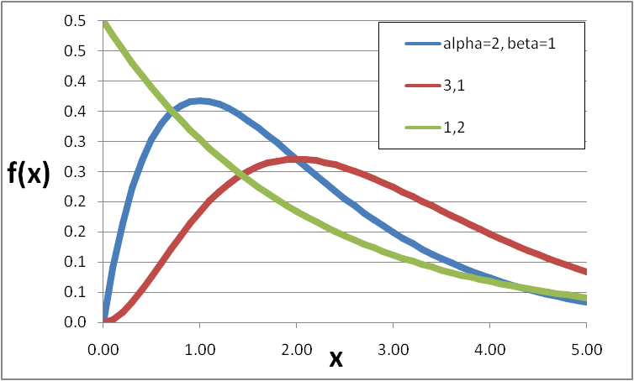
Gamma distribution

Slide 14
Facts on Gamma Distribution
Appropriate for time required for a total of exactly α independent events to take place if events occur at a constant rate 1/β
Has been used for storm durations, time between storms, downtime for offsite power supplies (nuclear)

Slide 15
Examples
If a part is ordered in lots of size α and demand for individual parts is 1/ β, then time between depletions is gamma
System time to failure is gamma if system failure occurs as soon as exactly α sub-failures have taken place and sub-failures occur at the rate 1/ β
The time between maintenance operations of an instrument that needs recalibration after α uses is gamma under appropriate conditions
Some phenomena, such as capacitor failure and family income are empirically gamma, though not theoretically

Slide 16
Practice
A ferry boat departs for a trip across a river as soon as exactly 9 cars are loaded. Cars arrive independently at a rate of 6 per hour. What is probability that the time between consecutive trips will be less than one hour? What is the time between departures that has a 1% probability of being exceeded?

Slide 17
Solution
Time between departures is gamma.
α=9 cars, 1/ β =6 per hour
Evaluate F(1) numerically
Matlab
  gamcdf(1,9,1/6)
  F=0.153
  Or
  f=@(x) x.^8.*exp(-6*x)
  6^9/gamma(9)*quad(f,0,1)

Slide 18
Solution continued
Solve this for x
gaminv(0.99,9,1/6)
Solution is x=2.9 hours
That is, the chances are 1 in 100 that the time between departures will exceed 2.9 hours

Slide 19
Generalized gamma distribution
We can redefine the gamma distribution to be 0 below some value (μ)

Slide 20
Exponential Distribution
This is just a gamma distribution with α=1 and β=1/λ

Slide 21
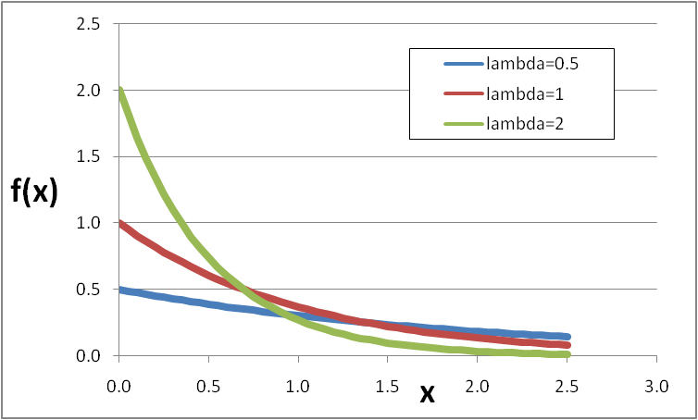
Exponential distribution

Slide 22
Facts (Exp Distribution)
Useful for time interval between successive, random, independent events that occur at constant rates
  Time between equipment failures, accidents, storms, etc.
Given our discussion of the gamma distribution, this distribution is a good model for the time for a single outcome to take places if events occur independently at a constant rate

Slide 23
Example
If particles arrive independently at a counter at a rate of 2 per second, what is the probability that a particle will arrive in 1 second?
λ=2
F(1)=1-exp(-2*1)=0.865

Slide 24
Beta Distributions
This is useful when x is bounded on both ends
x is bounded between 0 and 1
f can be u-shaped, single-peaked, J-shaped, etc.
The CDF is the incomplete beta function

Slide 25
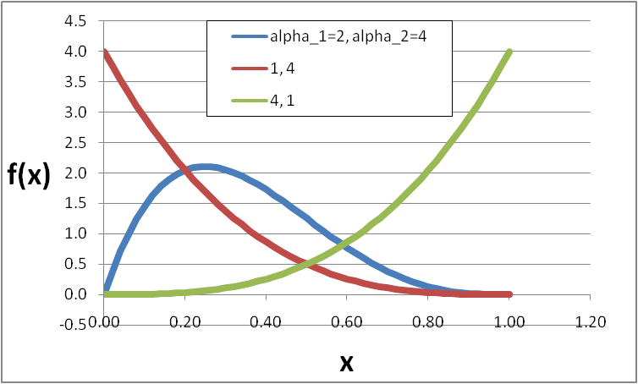
Beta distribution

Slide 26
Facts (Beta Distribution)
The many shapes this distribution can take on make it quite versatile
Often used to represent judgments about uncertainty
Can be used to represent fraction of time individuals spend engaging in various activities
…or fraction of time soil is available for dermal contact by humans (as opposed to being covered by soil and ice)
…or fraction of time individual spends indoors

Slide 27
More Examples
A measuring device allows the lengths of only the shortest and longest units in a sample to be recorded. 15 units are selected at random from a large lot. What is the probability that at least 90% have lot lengths between the recorded values?
20 electron tubes are tested until, at time t, the first one fails. What is the probability that at least 75% of the tubes will survive beyond t? Here, α₁=1 and α₂=0

Slide 28
Uniform Distribution
Actually a special case of the beta distribution (α₁=1 and α₂=1)

Slide 29
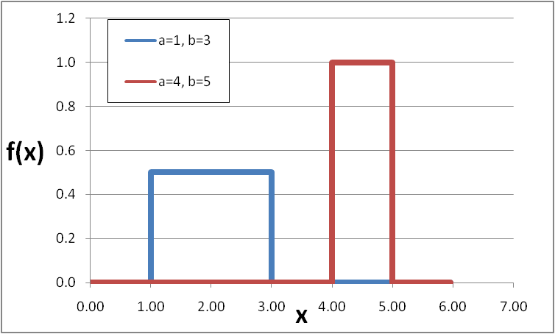
Uniform distribution

Slide 30
Lognormal Distribution
The natural log of the random variable follows a normal distribution
It can be modified to be 0 before some non-zero value of x

Slide 31
Lognormal Distribution
It can be used as a model for a process whose value results from the multiplication of many small errors in a manner similar to the addition of many instances we discussed with respect to the normal distribution
The product of n independent, positive variates approaches a log-normal distribution for large n

Slide 32
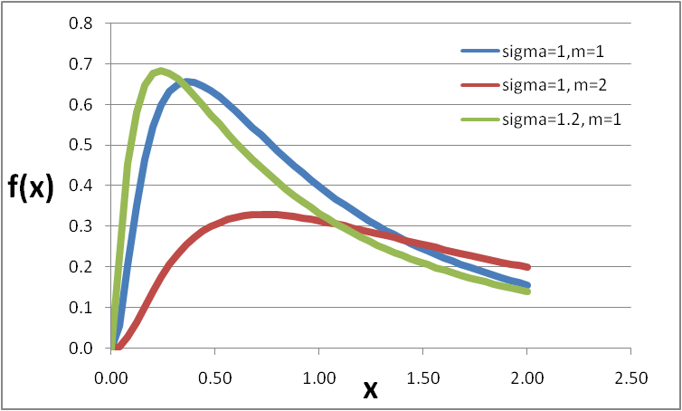
Lognormal distribution

Slide 33
Lognormal facts
Good for
  chemical concentrations in the environment, deterioration of engineered systems, etc.
  asymmetric uncertainties
  processes where observed value is random proportion of previous value
It is “tail-heavy”

Slide 34
Examples
Distribution of personal incomes
Distribution of size of organism whose growth is subject to many small impulses, the effect of each being proportional to the instantaneous size
Distribution of particle sizes from breakage

Slide 35
Statistical Models in Life Testing
Time-to-failure models are a common application of probability distributions
We can define a hazard function as
where f and F are the pdf and CDF for the time to failure, respectively
h(t)dt represents the proportion of items surviving at time t that fail at time t+dt

Slide 36
Hazard Functions
A typical hazard function is the so-called bathtub curve, which is high at the beginning and end of the life cycle
Uniform distribution – U(0,1)
Exponential distribution
Probability of failure during a specified interval is constant

Slide 37
Weibull Distribution
This is a generalization of the exponential distribution, but, for time-to-failure problems, the probability of failure is not constant

Slide 38
Weibull distribution

Slide 39
Weibull Facts
Useful for time to completion or time to failure
Can skew negative or positive
Less tail-heavy than lognormal

Slide 40
Extreme Value Distributions
Here we are interested in the distribution of the “largest” or “smallest” element in a group
For example,
  What is the largest wind gust an airplane can expect?

Slide 41
Types of EV Distributions
Type I (Gumbel) for maximum values
Type1 (Gumbel) for minimum values
Type III (Weibull) for minimum values

Slide 42
The Gumbel Distribution
Limiting model as n approaches infinity for the distribution of the maximum of n independent values from an initial distribution whose right tail is unbounded and is “exponential”
  original distribution could be exponential, normal, lognormal, gamma, etc. – all have proper characteristics

Slide 43
Type I EV
Can represent
  Time to failure of circuit with n elements in parallel
  Yearly maximum of daily water discharges for a particular river at a particular point
  Yearly maximum of the Dow Jones Index
  Deepest corrosion pit expected in a metal exposed to a corrosive liquid for a given time?

Slide 44
Type I (Gumbel)

Slide 45
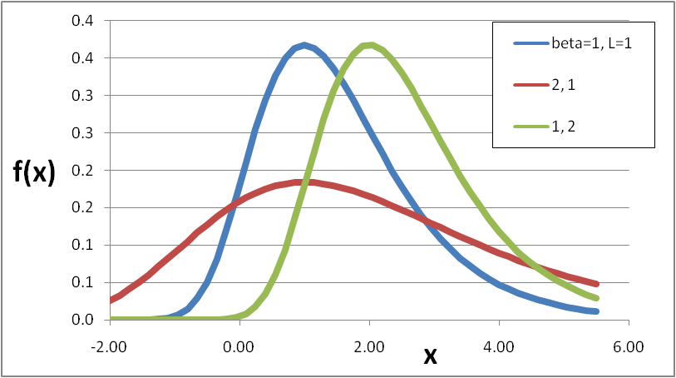
Gumbel distribution

Slide 46
Example
The maximum demand for electric power at any time during a year in a given locality is related to extreme weather conditions
Assume it follows a Type 1 distribution with L=2000 kW and β=1000 kW.
A power station needs to know the probability that demand will exceed 4000 kW at any time in a year and the demand that has only a 1/20 probability of being exceeded in a year

Slide 47
Solution
evcdf(4000,2000,1000)
=0.9994
For second part, solve F(y)=0.95 for y
evinv(0.95,2000,1000)
Result is 3097 kW

Slide 48
Type III
This is the Weibull distribution
It is the limiting model as n approaches infinity for the distribution of the minimum of n values from various distributions bounded at the left
The gamma distribution is an example
For example, a circuit with components in series with individual failure distributions that are gamma, then the Type III EV distribution is appropriate

Slide 49
Other examples
Failure strength of materials
Drought analyses

Slide 50
Observations
The log of the weibull distribution is distributed as a minimum value Type I
These extreme value distributions are only valid in the limit of large n – convergence depends on initial distributions
  10 samples can be adequate for initial distributions that are exponential
  It may take as many as 100 for normal distributions

