Slide 1
Histograms
Jake Blanchard
Spring 2010

Slide 2
Creating Histograms
Distribution functions are essentially histograms, so we should get some practice with histograms
We’ll use solar insolation as an example
  Daily insolation averaged over a month
  Data is for Madison, WI
  Units are W-hr/m²

Slide 3
Small Set
Data on next slide is for January, years 1961-1966
Divide results into bins
Count instances in each bin
Plot, usually with bar chart

Slide 4
January Insolation – 1961-1966
Year | Insolation (W-h/m²)
1961 | 1858
1962 | 1943
1963 | 2003
1964 | 1937
1965 | 1770

Slide 5
Categories
1700-1799 1 entry
1800-1899 1 entry
1900-1999 2 entries
2000-2099 1 entry

Slide 6
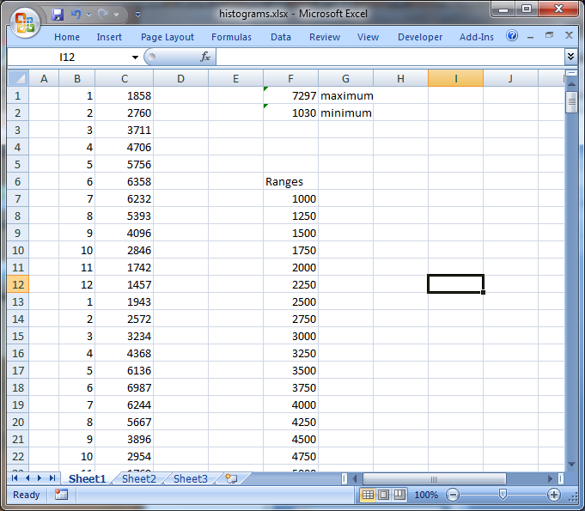
Histogram for Full Data Set (Excel)

Slide 7
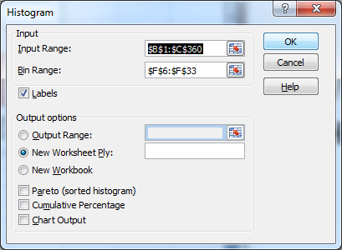
Excel
Go to Data/Data Analysis
Then pick Histogram

Slide 8
Matlab
data=xlsread('histograms.xlsx');
hist(data(:,2), 30)

Slide 9
Matlab
What if we just want the month by month data?
January June
January

Slide 10
Script
z=find(data(:,1)==1);
[N1,X1]=hist(data(z,2),10);
z=find(data(:,1)==6);
[N6,X6]=hist(data(z,2),10);
bar(X1,N1)
hold on
bar(X6,N6)

