Slide 1
Uncertainty in Engineering - Introduction
Jake Blanchard
Fall 2010

Slide 2
Instructor
Jake Blanchard
Engineering Physics
143 Engineering Research Building
blanchard@engr.wisc.edu

Slide 3
Course Web Site
eCOW2

Slide 4
Uncertainty Analysis for Engineers
Course Goals:
Students completing this course should be able to:
create probability distribution functions for model inputs
determine analytical solutions for output distribution functions when the inputs are uncertain
determine numerical solutions for these same output distribution functions
apply these techniques to practical engineering problems
make engineering decisions based on these uncertainty analyses

Slide 5
Grading
Homework – 30%
1 Midterm – 30%
Final Project – 40%
Due Thursday, December 21, 2010

Slide 6
Office Hours
Come see me any time
Email or call if you want to make sure I’m available

Slide 7
Topics
Introduction to Engineering Uncertainty and Risk-Based Decision Making
Review of Probability and Statistics
Probability Distribution Functions and Cumulative Distribution Functions
Multiple Random Variables (joint and conditional probability)
Functions of Random Variables (analytical methods)
Numerical Models
Monte Carlo
Commercial Software
Statistical Inferences
Determining Distribution Models
Goodness of Fit
Software Solutions
Regression and Correlation
Sensitivity Analysis
Bayesian Approaches
Engineering Applications

Slide 8
References
Uncertainty: A Guide to Dealing With Uncertainty in Quantitative Risk and Policy Analysis - Morgan & Henrion
Probability, Statistics, and Decision for Civil Engineers – Benjamin & Cornell
Risk Analysis: A Quantitative Guide – Vose
Probabilistic Techniques in Exposure Assessment – Cullen & Frey (on reserve)
Statistical Models in Engineering – Hahn & Shapiro (on reserve)
Probability Concepts in Engineering – Ang & Tang

Slide 9
Uncertainty in Engineering
Engineers apply scientific and mathematical principles to design, manufacture, and operate structures, machines, processes, systems, etc.
This entire process brings with it uncertainty and risk
We must understand this uncertainty if we are to properly account for it

Slide 10
Types of Uncertainty
Aleatory – uncertainty arising due to natural variation in a system
Epistemic – uncertainty due to lack of knowledge about the behavior of a system

Slide 11
An Example
Aleatory – radioactive decay
How long will it take for half of a sample to decay?
When will a particular atom decay?
Decay has an intrinsic uncertainty. No knowledge will help to reduce this uncertainty.
Epistemic – weather
We’re never quite sure what tomorrow’s weather will be like, but our ability to predict has improved

Slide 12
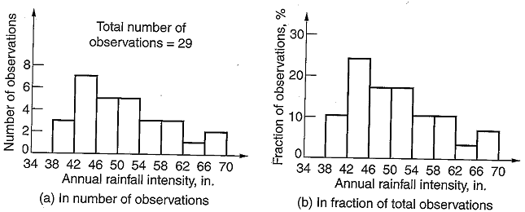
Some Examples

Slide 13
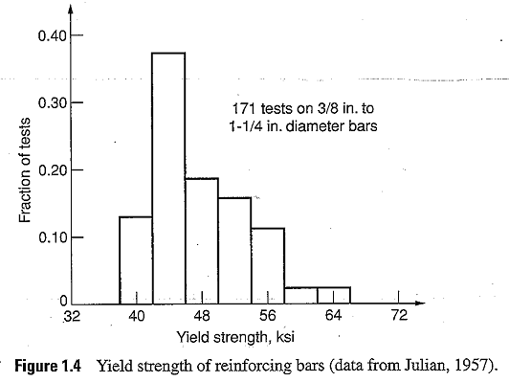
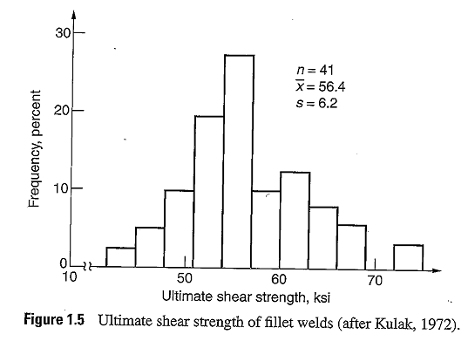
Some Examples

Slide 14
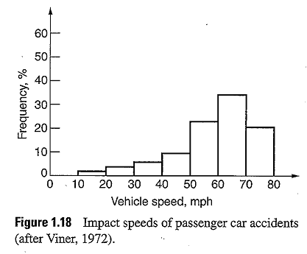
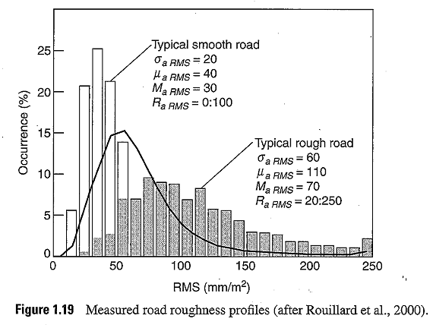
Some Examples

Slide 15
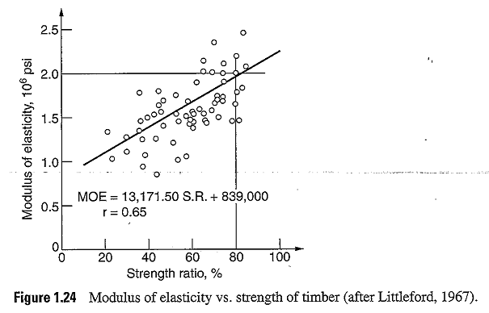
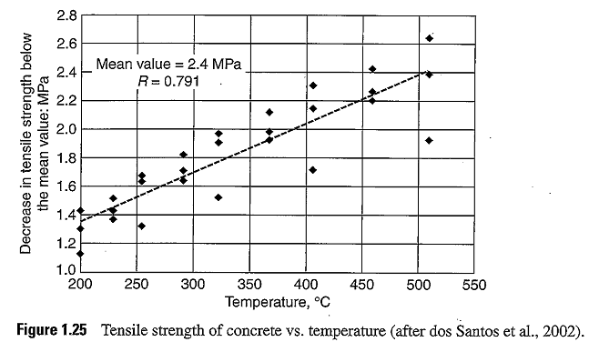
Some Examples

Slide 16
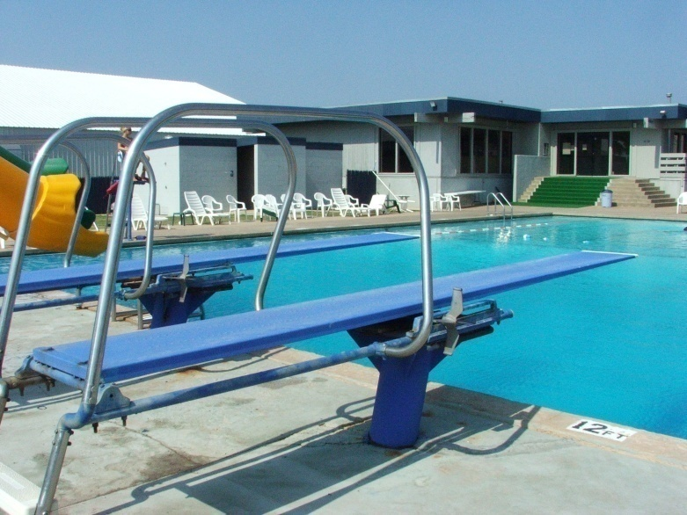
How Do We Deal With This?
Consider design of a diving board:

Slide 17
Diving Board
We need to get stiffness right to achieve desired performance
We need to make sure board doesn’t fail
Options:
Use worst-case properties and loads and small safety factor
Use average properties and large safety factor
Spend more on quality control for materials and manufacturing (still have uncertainty in loads)

Slide 18
Sensitivity vs. Uncertainty
Consider the system pictured below:
Fsin(ωt)
k
k
k
m
m
x₁

Slide 19
Sensitivity
Suppose we have a design (k=2, m=1, ω=1) and we want to see how far we are from resonance
Resonant frequencies are ω₁ and 1.73 ω₁
Or 1.41 and 2.45
Since the driving frequency is 1, we should be safe
To check, computing x ₁ gives 0.6*F1

Slide 20
Amplitude vs. Driving Freq. (F₁=1)

Slide 21
But What If Model Has Errors?
There are errors in the model:
Inputs might be wrong
Loads might be wrong
Driving frequency might be wrong
Etc.

Slide 22
How Sensitive is the Result to Variations in Inputs?
Relative change in amplitude as a function of relative change in 3 inputs (k=2; m=1)

Slide 23
Sensitivity for Different Defaults
k=10; m=1

Slide 24
Defaults Closer to Resonance
k=1.1; m=1

Slide 25
How Much Variation Do We Expect?
The final question is, how much variation do we expect in these inputs?
Can we control variation in spring stiffness and mass?
What about controlling the frequency?

Slide 26
Uncertainty Analysis
Assume all inputs have normal distribution with standard deviation of 1% of the mean
Plot is histogram of amplitudes

Slide 27
Uncertainty Analysis
What if inputs have standard deviation of 5% of the mean

Slide 28
10 Commandments of Analysis
Define the problem clearly
Let problem drive analysis (not available tools, for example)
Make the analysis as simple as possible
Identify all significant assumptions
Be explicit about decision criteria

Slide 29
10 Commandments (cont.)
Be explicit about uncertainties
Technical, economic, and political quantities
Functional form of models
Disagreement among experts
Perform sensitivity and uncertainty analysis
Which uncertainties are important
Sensitivity=what is change in output for given change in input
Uncertainty=what is best estimate of output uncertainty given quantified uncertainty in inputs

Slide 30
10 Commandments (cont.)
Iteratively refine problem statement and analysis
Document clearly and completely
Seek peer review

