Slide 1
Analysis of Contact
Jake Blanchard
Spring 2008

Slide 2
Analysis of Contact
Most commercial finite element programs will address contact problems
By “contact,” we mean the modeling of surfaces which are not attached to each other, but are in contact and transmit forces to each other
These calculations are inherently nonlinear and, on average, “trickier” than most of the calculations we’ve been doing
Friction is generally permitted

Slide 3
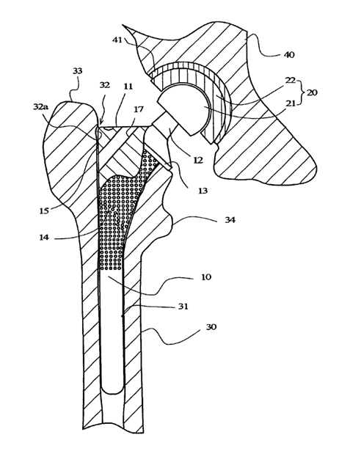
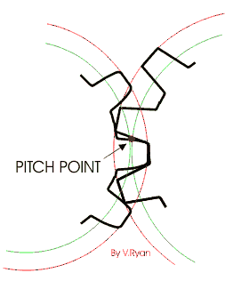
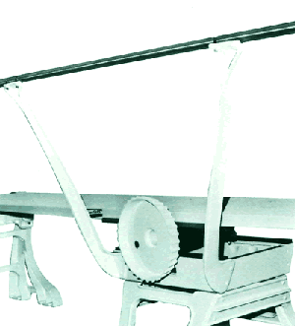
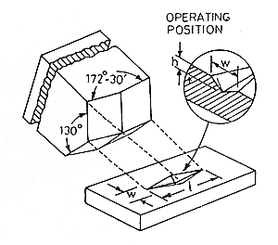
Applications
Hip joints
Gears
Indentation
Fulcrum on a diving board,
etc.

Slide 4
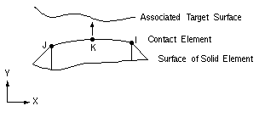
Contact Elements in ANSYS
Surface to Surface
CONTA171 - contact and sliding between 2-D “target” surfaces and a deformable surface (2 nodes)
CONTA172 – same, but with 3 nodes
CONTA173 – same, but 2-D, 4 nodes
CONTA174 – same, but 2-D, 8-node
All must be defined in conjunction with target elements (TARGE169, TARGE170)

Slide 5
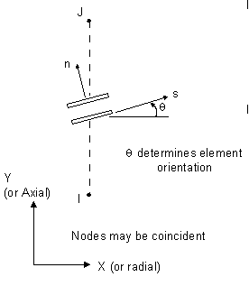
Contact Elements in ANSYS
Node to Node
CONTAC12 – 2-D point to point
CONTAC52 – 3-D point to point
CONTA178 – same (3-D) with damping

Slide 6
Contact Elements in ANSYS
Node to Surface
CONTAC26 - a surface which will resist penetration by a node
CONTAC48 - contact and sliding between two surfaces (or between a node and a surface) in 2-D
CONTAC49 – same, but 3-D
CONTA175 - contact and sliding between two surfaces (or between a node and a surface, or between a line and a surface) in 2-D or 3-D

Slide 7
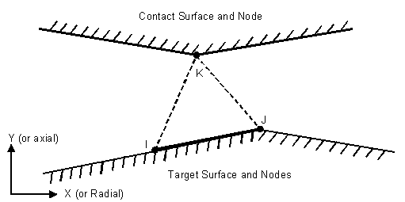
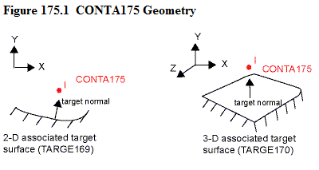
Node to Surface

Slide 8
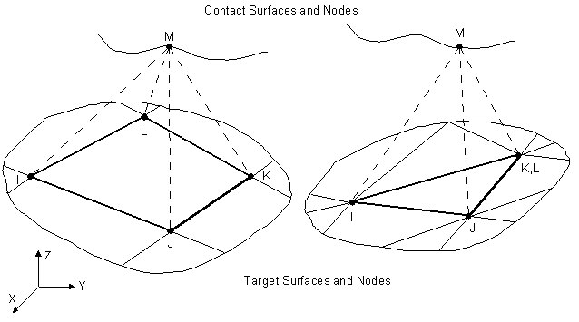
Node to Surface

Slide 9
Analysis Steps
Create the model geometry and mesh
Identify the contact pairs
Designate contact and target Surfaces
Define the target surface
Define the contact surface
Set the element KEYOPTS and real constants
Define/control the motion of the target surface (rigid-to-flexible only)
Apply necessary boundary conditions
Define solution options and load steps
Solve the contact problem
Review the results

Slide 10
Contact and Target Surfaces
If a convex surface is expected to come into contact with a flat or concave surface, the flat/concave surface should be the target surface.
If one surface has a fine surface mesh and, in comparison, the other has a coarse mesh, the fine mesh should be the contact surface and the coarse mesh should be the target surface.
If one surface is stiffer than the other, the softer surface should be the contact surface and the stiffer surface should be the target surface.
If higher-order elements underly one of the external surfaces and lower-order elements underly the other surface, the surface with the underlying higher-order elements should be the contact surface and the other surface should be the target.
If one surface is markedly larger than the other surface, such as in the instance where one surface surrounds the other surface, the larger surface should be the target surface.

Slide 11
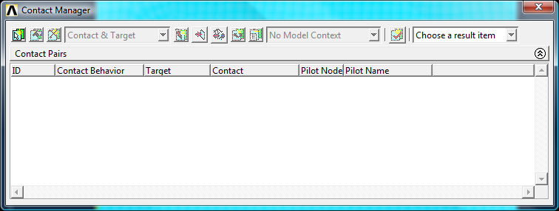
The Contact Manager
Preprocessor/Modeling/Create/Contact Pair

Slide 12
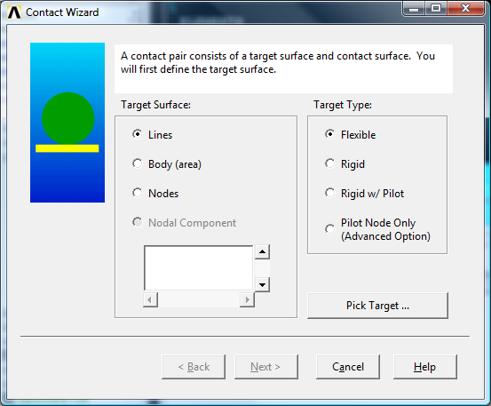
Contact Wizard

Slide 13
An Example
F
Rigid, spherical indenter into a ductile metal
E=70 GPa
υ=0.33
YS=100 MPa
Tangent modulus=700 MPa
Metal is 3 cm tall (solid) - radius=5 cm
Indenter is 1 cm radius
Try 4 mm deep indent

Slide 14
Example (continued)
Now try modeling indenter as elastic solid (hemisphere)
Use E=350 GPa, and υ=0.33 (sapphire)

