Slide 1
Plasticity
Jake Blanchard
Spring 2008

Slide 2
Analysis of Plastic Behavior
Plastic deformation in metals is an inherently nonlinear process
Studying it in ANSYS is much like a transient problem
Instead of time steps, we have load steps
Elements must support plasticity
We must define stress-strain curve

Slide 3
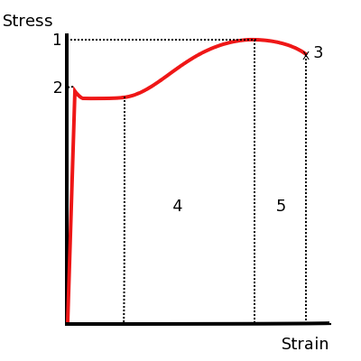
Typical Stress Strain Curve
UTS
YS
Rupture

Slide 4
Defining Materials in ANSYS
Start with elastic modulus, poisson’s ratio, and yield stress
Then we must define plastic behavior

Slide 5
Models in ANSYS
Bilinear Kinematic Hardening – constant slope after yielding
Multilinear Kinematic Hardening – series of straight lines after yielding
Nonlinear Kinematic Hardening
Similar models exist for isotropic hardening
Isotropic vs. kinematic determines how yield surface changes after yielding (kinematic means compressive yield increases as tensile yield increases)
Others are more exotic; these will suffice for our needs

Slide 6
Defining Parameters in GUI
Materials Model is:
Structural
Nonlinear
Inelastic
Rate Independent
Isotropic
Mises
Bilinear
Graph with Plot/Data Tables or List/Properties/Data Tables

Slide 7
Approach for inelastic analysis
Apply loads gradually – one load step with many substeps (ramped)
Second load step will remove the pressure
Even though analysis is quasi-static, we use time to differentiate load steps. So set time at end of first step to 1 second and time at end of second step to 2 seconds. (These are arbitrary.)
The first load step should still be in the elastic region.
I usually let ANSYS control time steps (automatic stepping).

Slide 8
Sample Problem
Thick cylinder
E=200 Gpa
υ=0.3
YS=150 MPa
Bilinear-kinematic hardening – slope after yielding=2 Gpa
Inner radius=20 cm
Outer radius=30 cm
Loaded by internal pressure

Slide 9
Steps
At what pressure will yielding first occur?
Where does yielding first occur?
What fraction of the cylinder area yields when the pressure increases to 1.2 times the yield pressure?
At what pressure does the entire area yield?
What happens if we remove the pressure after the entire area has just yielded?

