Slide 1
Transient Thermal Problems
Jake Blanchard
Spring 2008

Slide 2
Transient Analyses
So far, all the problems we’ve discussed in this class have all been steady state problems.
ANSYS is capable of doing a wide variety of transient problems.
We’ll explore this with a thermal problem.

Slide 3
Sample Problem
h=1000 W/m²-K
T_{b}=50 C
Channel is 3 cm in diameter
k=80 W/m-K
ρ=8000 kg/m³
c_{p}=500 J/kg-K
Do steady state analysis now.
3 cm
9 cm
9 cm
q=10⁴ W/m²

Slide 4
Transient Problem
The question is, if we start the body at a uniform temperature of 50 C, how long does it take to reach steady state?

Slide 5
Steps
Define time dependent loads (in load steps)
Set analysis parameters (time at end of load step, number of time steps, etc.)
Solve
Look at results

Slide 6
Load History for Sample Problem
Load Step 1: Ramp up flux
Load Step 2: Flux is steady
Load Step 3: Turn off flux and let structure cool back to 50 C
q (W/m-K)
10⁴
1000
5000
Time (s)

Slide 7
Setting Up a Time Step
Set parameters for end of step (mostly loads)
Set time for end of step
Set number of time steps
Save settings

Slide 8
First Load Step
Set analysis type to transient (Solution/Analysis Type/New Analysis)
Set time at end of step to 1,000 seconds (Solution/Analysis Type/Sol’n Controls)
Set initial temperatures (Define Loads/Apply/Initial Condition/Define)
Set convection and heat flux loads (heat flux is value at end of step)
Choose Ramped or Stepped
Only load is convection

Slide 9
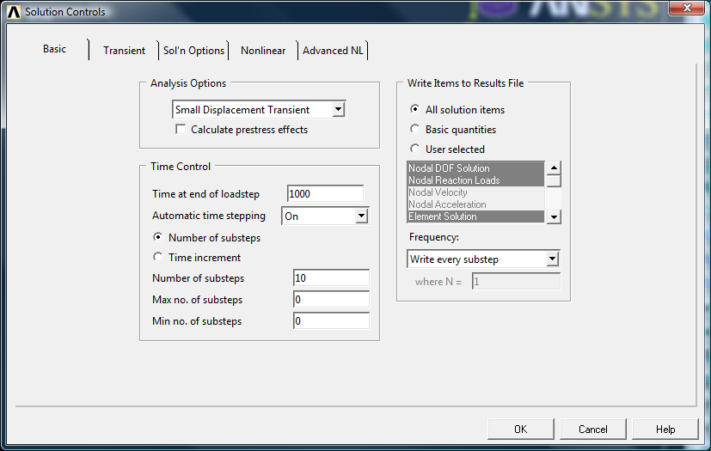

Slide 10
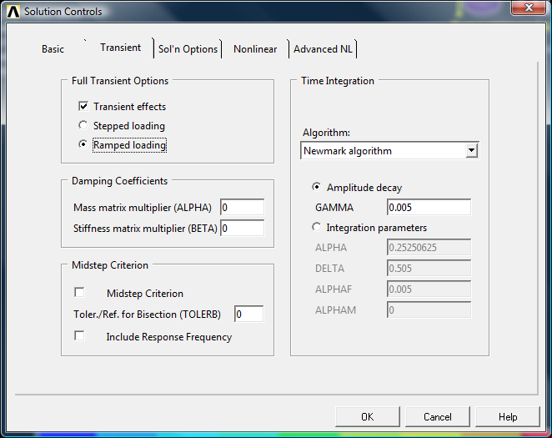

Slide 11
Post Processing
Options
Read a load step, then do usual postprocessing (contour plots, etc.)
Use time history processor to plot a particular value as a function of time
Animate contours (try PlotCtrls/Style/Contours/Uniform Contours)

Slide 12
Load Step 2
Only change is time at end of step (loads don’t change)
Solve

Slide 13
Load Step 3
Delete heat flux
Set time at end (try 10,000 seconds)
Solve

