Slide 1
Shell Elements
Jake Blanchard
Spring 2008

Slide 2
Shell (or plate) Elements
These are typically “planar” elements
They are used to model thin structures which will experience bending
It is difficult to model thin structures with 3-D elements, because many are needed through thickness to capture bending behavior
Element features
6 DOF per node (3 translations and 3 rotations) for 3-D elements
Bending modes are included
More than 1 stress at each point on the element

Slide 3
Shell Elements in ANSYS
SHELL 61 = 2-node, axisymmetric shell – 4 DOF/node (3 translation and one rotation)
SHELL 208 = like 61, but finite strain
SHELL 209 = like 208, but with midside node (3-node element)
SHELL 28 = shear twist panel – 3 DOF/node (3 translation or 3 rotation)
SHELL 41 = 3-D quad or triangle with membrane only
SHELL 43 = 4-node shell with 6 DOF/node (plastic)
SHELL 63 = 4-node shell with 6 DOF/node (elastic only)
SHELL 93 = Like 63, but with midside nodes
SHELL 150 = 8-node p-element
SHELL 181 = 4-node, finite strain
SHELL 281 = 8-node, finite strain

Slide 4
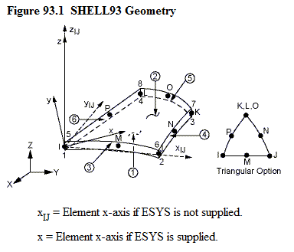
Real Constants
TK(I), TK(J), TK(K), TK(L)

Slide 5
Assumed Behavior
Stresses are assumed to be linear through the thickness
Middle surface has 0 bending stress
Membrane stresses are uniform over thickness

Slide 6
Boundary Conditions
Clamped Edge
No displacements or rotations
Simply-Supported Edge
No displacements
Rotation is allowed perpendicular to edge

Slide 7
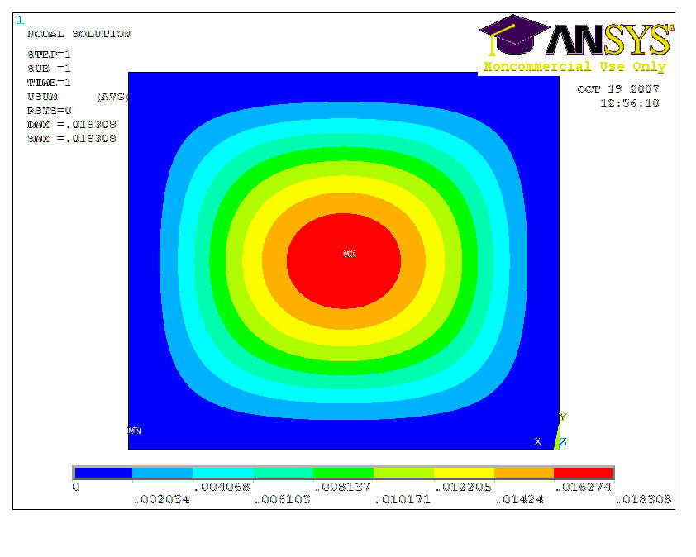
Clamped Edges

Slide 8
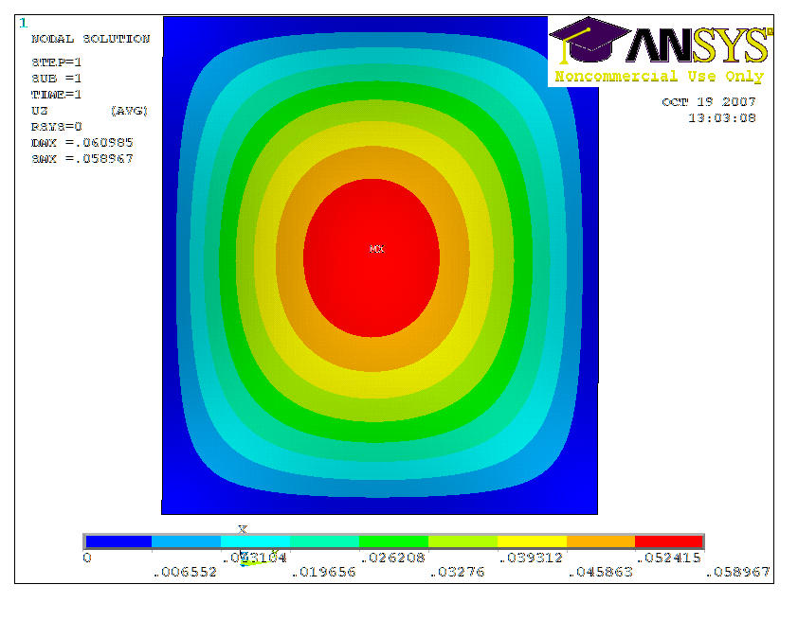
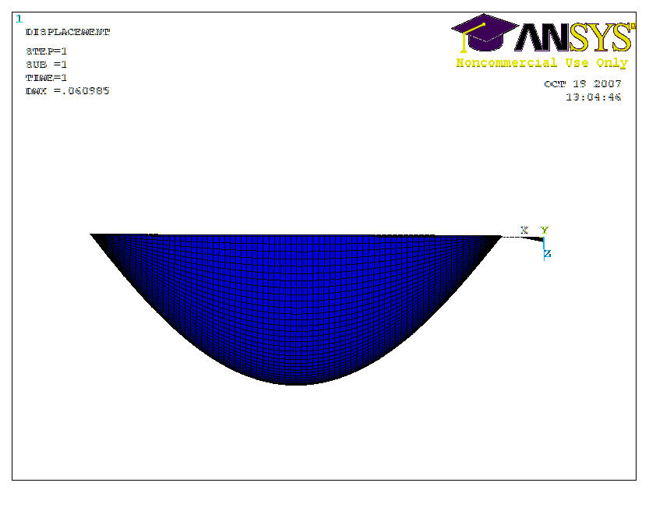
Simply Supported

Slide 9
In-Class Problems
Consider a flat plate
1 m on each side
10 cm thick
E=200 GPa, ν=0.3
Uniform transverse pressure on entire face (1 MPa)
Two opposite sides are clamped, other two are simply supported
Expect max stress of 42 MPA, max displacement of 0.1 mm

Slide 10
Circular plate
Plate is 1 m diameter (2R), 1 cm thick
Transverse pressure (1 MPa) is applied over inner circle with diameter of 20 cm (2r₀)
E=200 Gpa, ν=0.3

Slide 11
Pressure Vessel
End-Cap is hemispherical
R=2.2 m, t=0.2 m
P=1 MPa
E=200 Gpa, ν=0.3
R
2R

