Slide 1
Sections
Jake Blanchard
Spring 2008

Slide 2
Sections
If you don’t want to define all the areas and moments of inertia for your model, you can define the sections.
For beams, this is only supported by the following elements:
BEAM44 – 3-D tapered unsymmetric
BEAM188 – 3-D finite strain
BEAM189 – 3-D, 3-node finite strain

Slide 3
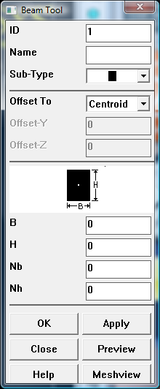
Beam Tool
Sections/Beam/Common Sections
Pick any name
Sub-type is type of x-section
Nb and Nh relate to # divisions (cells)

Slide 4
Usage
Sections have an ID number
They are attached to elements, much like materials or element types
Review with List/Elements

Slide 5
Now Try a Frame
F (out of plane)=1 N
3 m
2 m
Cross-sections
5 cm
6 cm

