Slide 1
A Case Study
Jake Blanchard
Spring 2008

Slide 2
How do we really use FEM?
The use of FEA is really more complicated than we have made it.
The complication lies in converting a real structure into a numerical model.
What are loads?
What are boundary conditions?
What features can we ignore?
Etc.
We also must ensure that our models are correct.
Testing will almost always be used before final production.

Slide 3
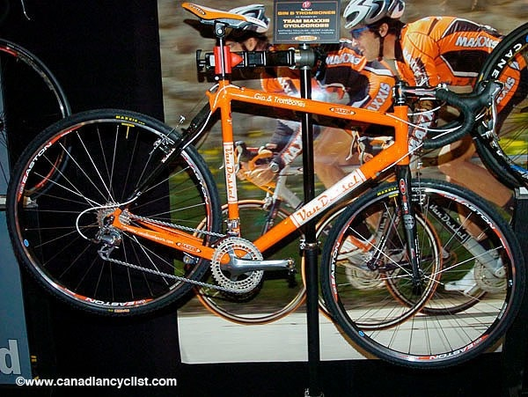
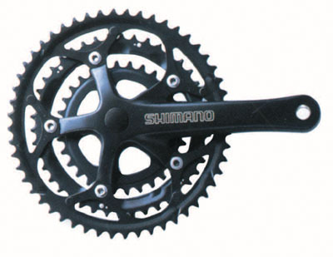
Our Case – A bicycle crank

Slide 4
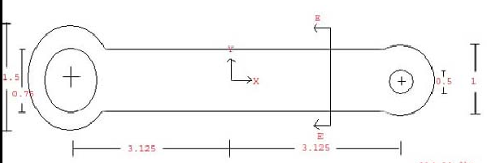
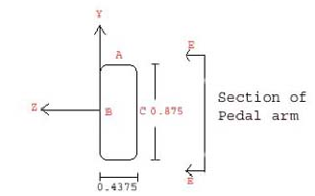
Our Model

Slide 5
What loads should we use?

Slide 6
What properties should we use?
Aluminum alloy (2024-T4 Aluminum)
Element | Content (wt %)
Al | 90.7-94.7
Cr | 0.1 Max
Cu | 3.8-4.9
Fe | 0.5 Max
Mg | 1.2-1.8
Mn | 0.3-0.9
Si | 0.5 Max
Ti | 0.15 Max
Zn | 0.25 Max
Property | Value | Units
Density | 0.1 | psi
E | 10,600 | ksi
ν | 0.33
UTS | 68 | ksi
YS | 47 | ksi
Toughness | 23.7 | ksi-in^{0.5}
Elongation | 19 | %

Slide 7
What are the boundary conditions?

Slide 8
What stresses do we expect?

Slide 9
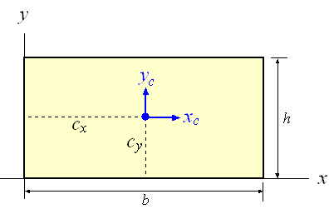
Background: Torsion
Polar Moment of Inertia
Stress

Slide 10
What are the stress limits?

Slide 11
No do the analysis and assess

Slide 12
What design changes might be made?

Slide 13
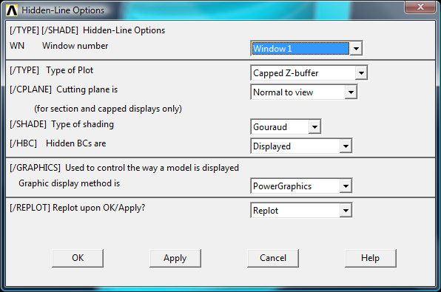
Viewing Contours on Cross Section
In 3-D models, it can be useful to view contours on a slice of the part
Try this: Plot Ctrls/Style/Hidden Line Options…

