Slide 1
Mapped Meshing
Jake Blanchard
Spring 2008

Slide 2
Here we continue the meshing from last time
3-D meshing options:
Free mesh a volume with tetrahedral elements
Extrude a meshed area
Sweep
Create volume
Mesh an area
Sweep through volume
Delete 2-D elements
Mapped Meshing

Slide 3
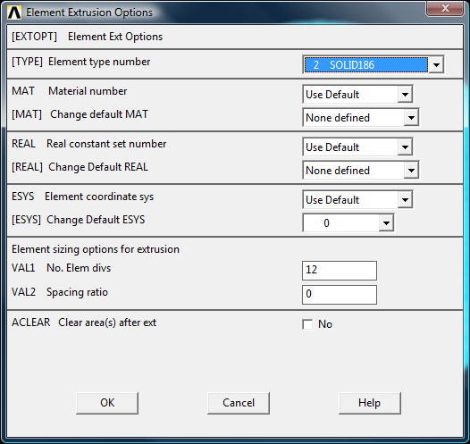
Extruding meshed area
Add both 2-D and 3-D elements to database
Create area and mesh it
Set extrude options
Extrude area
Be sure 2-D elements are gone before solving

Slide 4
Example: Mapped Mesh
Consider a cylinder
Approach is to:
Create areas
Divide them as needed
Set sizes on appropriate lines
Extrude areas about axis
Create Mapped Hex meshes, one volume at a time

Slide 6
