Slide 1
Modeling and Meshing for 3-D Analyses
Fall 2007

Slide 2
Some Modeling Approaches
Extrusion – Take an area and “extrude” it into a 3-D volume (Modeling/Operate/Extrude/Areas)

Slide 3
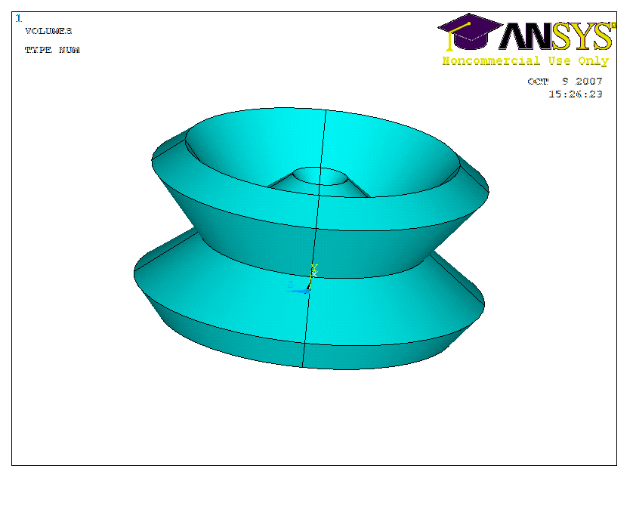
Extrusion (continued)
You can also extrude about an axis
Axis is identified by keypoints

Slide 4
Extrusion (continued)
You can extrude in cylindrical coordinates

Slide 5
Swept Meshing
Sweeping can help us mesh with hex elements
Just mesh an area with 2-D elements and then sweep to volume

Slide 6
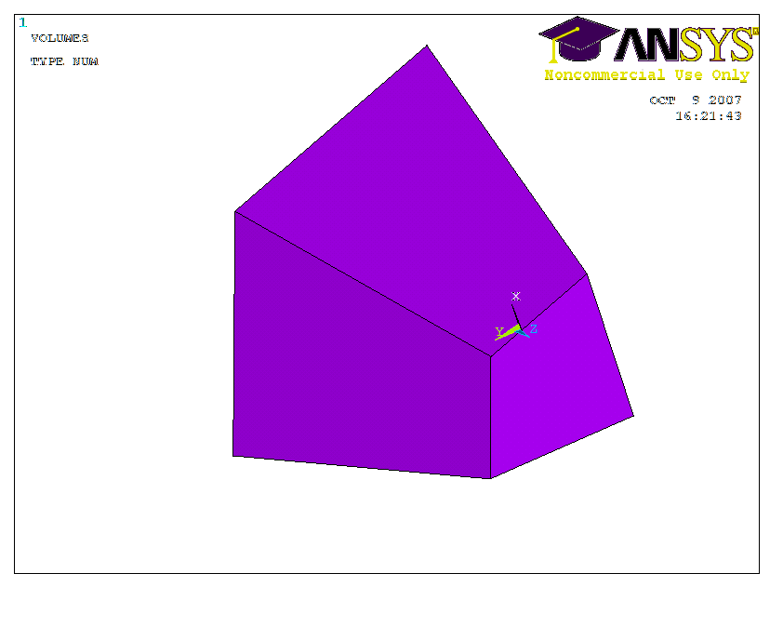
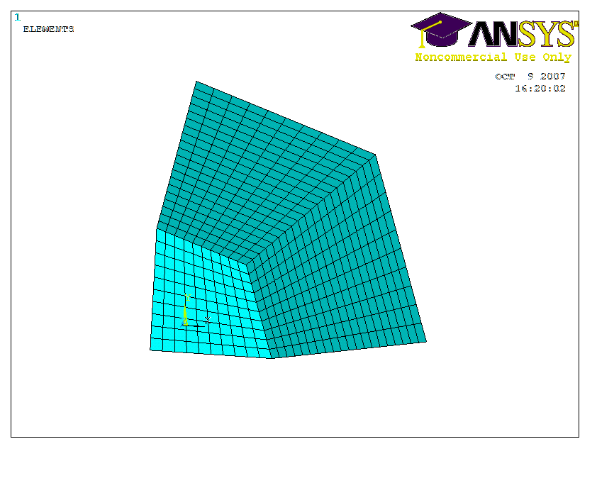
Mapping
Works for areas made of 3 or 4 lines
Make sure all lines have right number of divisions
Mesh one area

