Slide 1
EMA 405
3-D Elements

Slide 2
Introduction
3-D elements have 3 degrees of freedom per node (u_{x}, u_{y}, u_{z})
The two fundamental shapes are hexahedral and tetrahedral elements

Slide 3
Comments
Mesh generation is easier with tetrahedral elements
Tetrahedral elements tend to produce more degrees of freedom in a given model
Try mapped meshing if you want to use hex elements

Slide 4
4-node Tetrahedral element
Constant Strain

Slide 5
10-node Tetrahedral element
Linear Strain

Slide 6
8-node Hexahedral element
Linear Strain

Slide 7
20-node Hexahedral element
Quadratic Strain
Not compatible with 10-node tetrahedral elements

Slide 8
Boundary Conditions
We have to restrict 3 translational rigid body modes and 3 rotational rigid body modes
We can restrict a single node in all 3 directions to take care of the translational modes
Rotations are trickier

Slide 9
Boundary Conditions continued
Consider a 2-D case
With one node restricted in all directions, rotation about z-axis is possible
Restricting one node on x-axis in y-direction will prevent rotation about z
Do similar things to restrict rotations about x and y
Restrict in x and y
y
Restrict in y
x

Slide 10
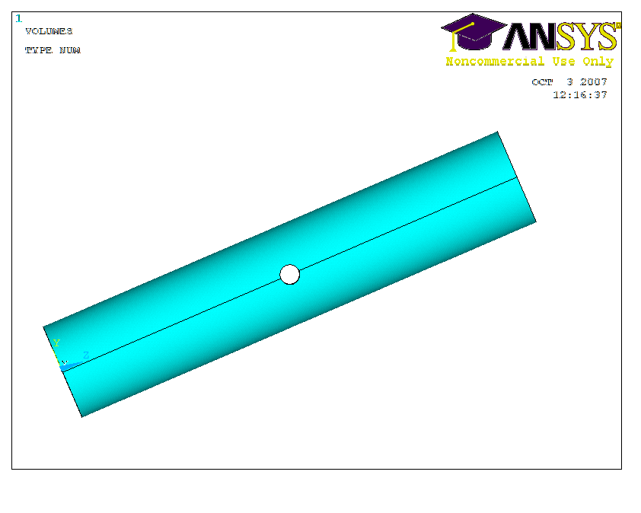
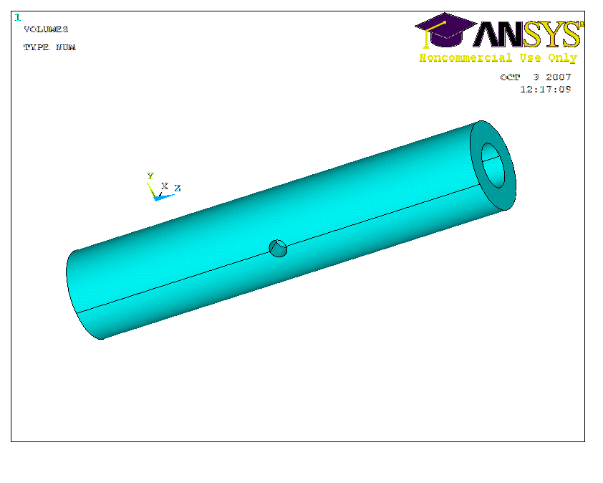
Example – hollow cylinder with hole
E=100 Gpa, ν=0.3
L=80 mm
Pressure load=1 Mpa (applied on end faces)
Inner radius=7.5 mm
Outer radius=10 mm
Radius of hole=2.5 mm
Theory says peak stress is 3.65 MPa

