Slide 1
EMA 405
Axisymmetric Elements

Slide 2
Introduction
Axisymmetric elements are 2-D elements that can be used to model axisymmetric geometries with axisymmetric loads
These convert a 3-D problem to a 2-D problem
Smaller models
Faster execution
Easier postprocessing
We only model the cross section, and ANSYS accounts for the fact that it is really a 3-D, axisymmetric structure (no need to change coord. Systems)

Slide 3
Modeling
To model this:
We just need this:

Slide 4
Modeling
To model this:
We just need this:

Slide 5
Modeling
To model this:
We just need this:

Slide 6
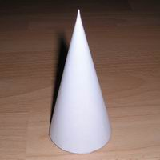
Modeling
To model this:
We just need this:

Slide 7
How would you model this?

Slide 8
How would you model this?

Slide 9
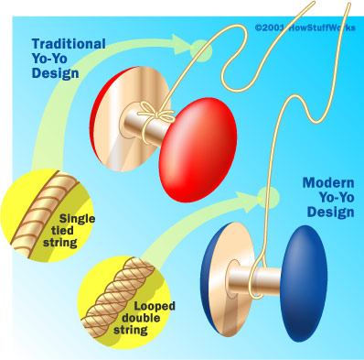
How would you model this?

Slide 10
How would you model this?

Slide 11
Note
In ANSYS, axisymmetric models must be drawn in the x-y plane.
The x-direction is the radial direction.
The 2-D model will be rotated about the y-axis (and always about x=0)
Nothing in your model should be in the region x<0
In postprocessing, σ_{x} will be the radial stress, σ_{y} will be the axial stress, and σ_{z} will be the “hoop” stress

