Slide 1
EMA 405
3-D Truss Example

Slide 2
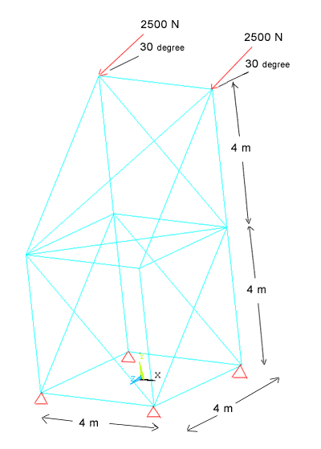
A 3-D Truss
Use 3-D spar (link8)
A=0.0015 m2
E=75 Gpa (Aluminum)
Loads in y-z plane
Find
deflections
Stresses
reactions

