Slide 1
EMA 405
Tips for Using Truss Elements in ANSYS

Slide 2
Truss Elements in ANSYS
We don’t really need to “mesh” a truss model
Just define nodes directly (Modeling/Create/Nodes/In Active CS)
All you need is one element per “line” in the truss model
Then create elements (Modeling/Create/Elements/Auto Numbered/Thru Nodes)
Apply boundary conditions and loads to nodes

Slide 3
Truss Element Types in ANSYS
Besides trusses, link elements are commonly used to model cable systems, springs (k=EA/L), and actuator arms. ANSYS has 5 link elements in its library.
Link1 – 2D spar: Model must be completely in x-y plane
Link8 – 3D spar
Link10 – Bilinear 3D Spar: allows for the creation of tension only or compression only elements. Useful for modeling cables or contact only supports
Link11 – ANSYS calls this a linear actuator, but it can be thought of as a shock absorber as damping as well as spring stiffness is applied.
Link180 – 3D finite strain spar: similar to link8 but with improved nonlinear capabilities. The higher number indicates this is a newer element in the ANSYS family.

Slide 4
Post Processing
To get stresses in elements, go to: General Postproc/List Results/Element Solution and then Stress/Line Element Results

Slide 5
A Test Problem
E=200 GPa
υ=0.27
A=2 cm²
Use 2-D spar element
Expected results: dmax (usum)=22.2 microns; smax=2.6 MPa
35 cm
50 cm
F=300 N

Slide 6
Changing Element Properties
If you want to alter the properties of elements after they are created
Create second set of properties (real constants, element type, material properties, etc.)
Then go to Modeling/Move or Modify/Elements/Modify Attrib
To check, go to List/Elements

Slide 7
A Slight Modification
Now switch “angled” bar to E=300 GPa and A=4 cm²
Expected Results: dmax=13.4 microns; smax=1.31 MPa

Slide 8
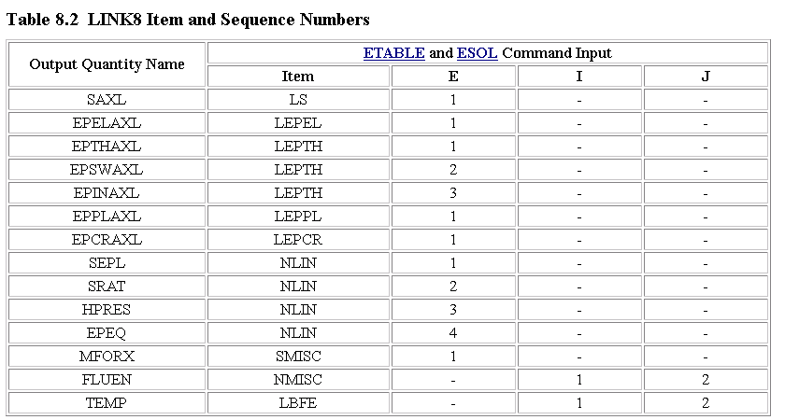
Getting Results From the Element Table
For line elements (links, beams, etc. ) the Element Table is used to access results data. The Element Table is different for each element, therefore, we need to look at the help file for LINK1 or LINK8 (Type help link8 in the command line). From Table 8.2 in the Help file, we can see that the stress (SAXL) can be obtained 1using the item 'LS,1‘, and the element load (MFORX) using ‘SMISC,1”.

Slide 9
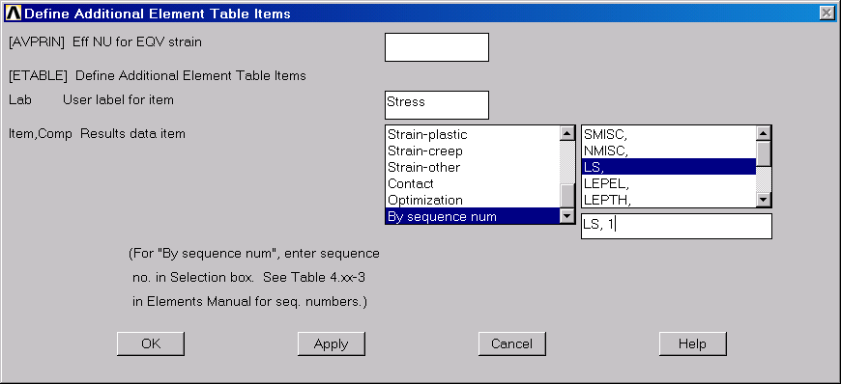
Element Table Continued
From the General Postprocessor menu select Element Table >Define Table
Click on 'Add...'
Type in a label (I used stress)
Scroll down through the items and select by sequence number
Select LS and then type 1 after LS, and hit apply
In a similar manner, add an entry for the element forces (SMISC,1)
These items may now be plotted or listed

Slide 10
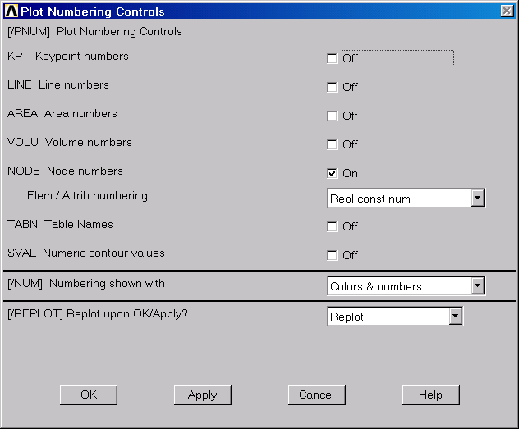
Numbering and Load Labels
The numbers associated with the nodes and elements may be displayed using Plot Controls >Numbering. To show the material or real constant associated with each element, select that item from the Elem/Attribute scroll list.
The load and boundary condition labels can be refreshed by Plot Controls >Symbols and selecting all applied B.C.s

