Slide 1
EMA 405
Truss Elements

Slide 2
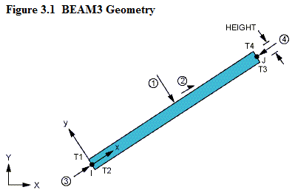
Truss Elements
Used for “bridge” analysis, cranes, etc.
Support only tension or compression (no bending, hinged at ends)
2 degrees of freedom (u_{x} and u_{y}) per node for 2-D bar

Slide 3
Stiffness for Truss Elements
F₁
A, E
F₂
u₁
u₂
L

Slide 4
A Global Element Matrix (Example)
A, E
A, E
P
u₁
u₂
u₃
L
L

Slide 5
Solution

