Slide 1
EMA 405
Introduction

Slide 2
Syllabus
Textbook: none
Prerequisites: EMA 214; 303, 304, or 306; EMA 202 or 221
Room: 2261 Engineering Hall
Time: TR 11-12:15
Course Materials: ecow2.engr.wisc.edu

Slide 3
Instructors
Jake Blanchard, Room 143 ERB,
phone: 263-0391
e-mail: blanchard@engr.wisc.edu
office hours: TBD

Slide 4
Grading
Homeworks – 40%
Quiz – 20%
Design Problem – 20%
Final Project – 20%

Slide 5
Schedule
Topics
Introduction FEA Theory Intro to ANSYS Trusses Plane Stress/Strain Axisymmetric 3-D Problems Beams Plates Heat Transfer Multiple Load Steps Plasticity

Slide 6
The finite element method
Began in 1940’s to help solve problems in elasticity and structures
It has evolved to solve nonlinear, thermal, structural, and electromagnetic problems
Key commercial codes are ANSYS, ABAQUS, Nastran, etc.
We’ll use ANSYS, but other codes are as good or better (…a “religious” question)

Slide 7
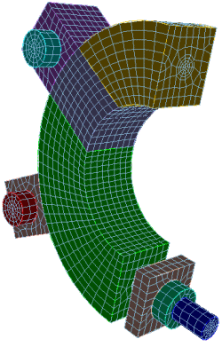
The Process
Build a model
Geometry
Material Properties
Discretization/mesh
Boundary conditions
Load
Solve
Postprocessing

Slide 8
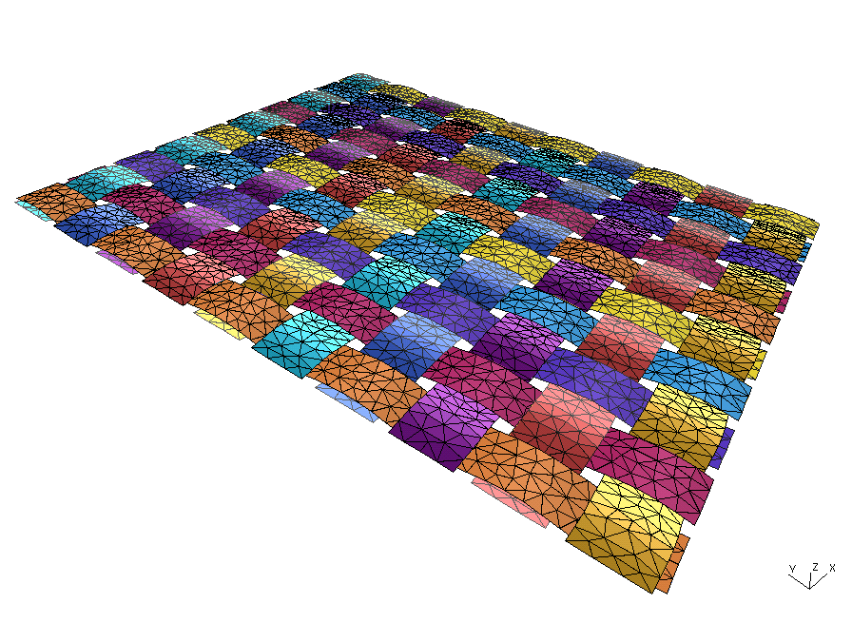
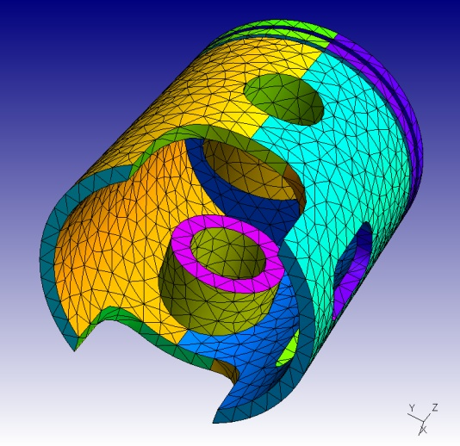
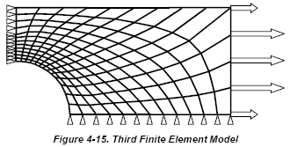
Structural Elements
Truss
Beams
Planar
3-D
Plate

Slide 9
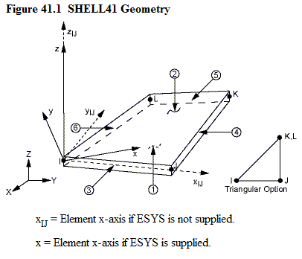
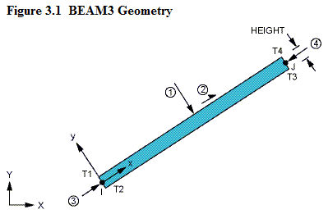
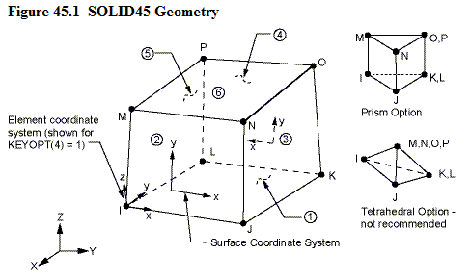
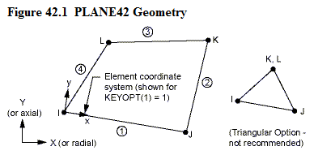
Elements
Truss
Beam
Planar
Shell
Brick

Slide 10
Finite Element Fundamentals
The building block of FEM is the element stiffness matrix
3
a
1
2
a

Slide 11
Now Put Several Together
7
8
9
5
4
6
1
3
2

Slide 12
Global Stiffness
[K] is a composite of the element stiffness elements
Once K is known, we can choose forces and calculate displacements, or choose displacements and calculate forces
Boundary conditions are needed to allow solution

Slide 13
Element Stiffness
f_{3y}
f_{3x}
3
a
f_{2y}
1
2
f_{1y}
a
f_{1x}
f_{2x}
v₃
u₃
y
v₂
v₁
x
u₁
u₂

Slide 14
How Do We Get Element Stiffness?
Rewrite as matrix equation
Coordinates of element corners
Substitute coordinates into assumed functions

Slide 15
Continued…
Multiply
Rewrite assumed functions
Substitute

Slide 16
Continued
Collect terms

Slide 17
Stress-Strain

Slide 18
Stress-Strain
Comes from minimizing total potential energy (variational principles)

Slide 19
Material Properties
[D] comes from the stress-strain equations
For a linear, elastic, isotropic material
Strain Energy

Slide 20
Final Result for Our Case

Slide 21
or

Slide 22
Examples
u₁

Slide 23
Examples
v₁

Slide 24
Prescribe forces
F

Slide 25
Process
What do we know? – v₁=v₂=0; f_{3y}=F; all horizontal forces are 0
Remove rigid body motion – arbitrarily set u₁=0 to remove horizontal translation; hence, f_{1x} is a reaction
Reduce matrix to essential elements for calculating unknown displacements – cross out rows with unknown reactions and columns with displacements that are 0
Solve for displacements
Back-solve for reaction forces

Slide 26
Equations

Slide 27
Solution

Slide 28
Putting 2 Together
3
4
2
a
1
1
2
a

Slide 29
Element 2 Stiffness Matrix
2
(3)
1 (4)
3
Rotate 180º
1
2
3 (2)
c s 0 0 0 0
-s c 0 0 0 0
0 0 c s 0 0
0 0 -s c 0 0
0 0 0 0 c s
0 0 0 0 -s c
K’ = T^{T}KT
For 180º rotation
K’=K
Just rearrange the rows and columns top correspond to global numbering scheme (in red).
T =

Slide 30
Element Matrices
Element 1
Element 2

Slide 31
Add the element matrices

Slide 32
What if triangles have midside nodes?
3
4
5
1
2
6

Slide 33
What about a quadrilateral element?
3
4
1
2

Slide 34
What about arbitrary shapes?
For most problems, the element shapes are arbitrary, material properties are more general, etc.
Typical solution is to integrate stiffness solution numerically
Typically gaussian quadrature, 4 points

